Slide 1
Elusen Missing People a Llinell Gymorth Runaway
Notes:
I am here today to tell you about a service called the Runaway helpline. You may have heard or seen news items on social media about young people who have gone missing

Slide 2
Faint o blant ac unigolion ifainc ydych chi’n credu sy’n mynd ar goll bob blwyddyn?
Notes:
Ask the learners for estimates first.
Explain the figure of 140,000 per year, that’s one every 5 minutes
Explain that most will be found safe and well but it’s really important that we move as quickly as possible
Acknowledge that sadly, some do not get found so quickly

Slide 3
Pam fyddai rhywun yn rhedeg i ffwrdd?
Annibyniaeth
Ffraeo gyda’r teulu
Trosedd
Cyffuriau neu alcohol
Bwlio
Cam-drin
Problemau gyda sboner/wejen
Rhesymau diwylliannol
Straen
Teimlo’n anniogel/anhapus
Notes:
There are many reasons why a child or teenager might go missing.
Ask the learners for their ideas.
Discuss the key reasons why an individual might feel unsafe or unhappy
Mention that the Runaway helpline supports young people, regardless of their reason for running away.

Slide 4
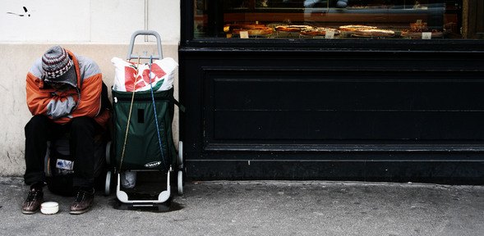
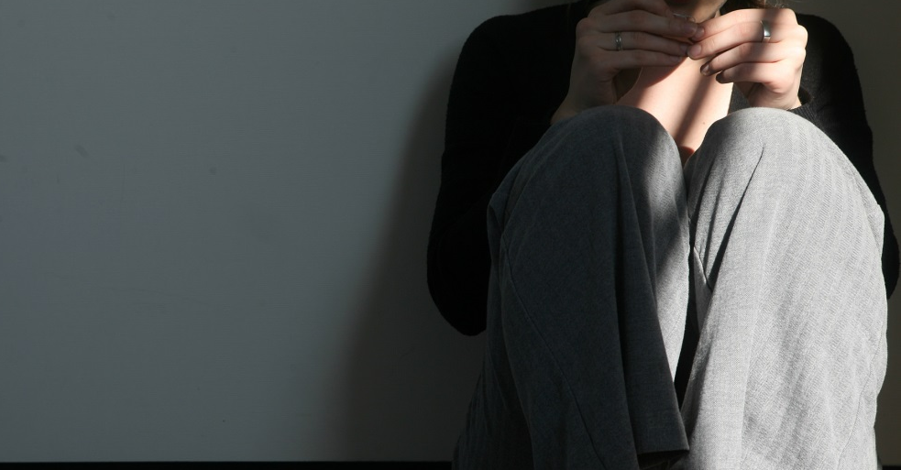
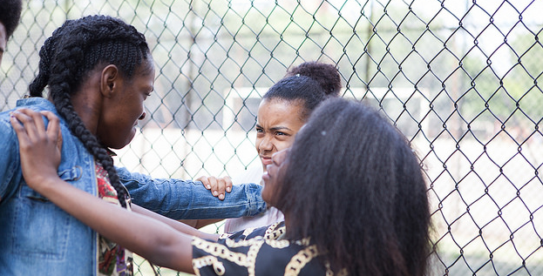
Peryglon rhedeg i ffwrdd
1 in 6 slept on
the street
1 in 8 had to steal to survive
1 in 9 did ‘other things’ in order to survive
1 in 9 are harmed while away from home
Notes:
Click to reveal the statistic that accompanies each image.
Ensure learners understand that young people may feel like they have to run away, however, choosing to do so puts them at serious risk.
The Runaway helpline wants to make sure everyone knows to contact them if they are thinking about it, or if they have left home.
Our priority is the person’s safety, we won’t make anyone do anything they don’t want to do.

Slide 5
Sut allwn ni helpu
Os ydych chi’n ystyried rhedeg i ffwrdd, gallwch ffonio ni a thrafod eich opsiynau
Contact us if you’re worried about a friend running away, or if someone is pressuring you to
If you have run away we can give you practical advice and emotional support

Slide 6
Stori Abi
Notes:
Abi is a 15 year old girl living in a small Welsh town.
She has been living with her Gran for 3 months since she fell out with her mother over her Mum’s new boyfriend.
After coming home very late one night Abi’s Gran was very annoyed that she hadn’t come home on time. After a heated row Abi ran away in the middle of the night and has since been staying with a friend.
When Gran found out that Abi had disappeared she firstly phoned everyone she could of to see if Abi was with them. Finally she was so worries she phoned the police to report that Abi had gone missing.
The Runaway helpline contacted Abi by sending a TextSafe message to let her know she could call the helpline for confidential support.
Reassured by the fact that the call was confidential Abi phoned the helpline.
Rima, the helpline worker, listened to Abi carefully and encouraged her to speak to a trusted adult about her problems.
Abi said she could chat with one of her teachers who had helped her before when her Dad left. Rima explained to Abi that until she was sure she was safe and well the police would need to continue looking for her.
Rima explained that if Abi was ready, Rima could stay on the line and connect Abi to the police without letting on where she was.
She reassured Abi that the service was confidential, and would not share any information about her without her permission – UNLESS THRER WERE SIGNIFICANT CONCERNS ABOUT HER SAFETY.
Abi agreed to do this and spoke to the Police on the phone. PC Jenny was very supportive and finally Abi told her where she was staying. PC Jenny said she would have to send some officers around to check that she was OK.
Rima promised that there would be someone to listen to her at any time if she needed further help or support.
Later that week, Abi saw the teacher who helped her to think through going back to Gran’s.
During the call
Abi called in to the Runaway helpline after receiving a Text Safe message from the charity.
A TextSafe message is a text that Runaway helpline can send to a missing person’s phone to let them know they can call the helpline for confidential support.
During the call, Abi explained that she was unhappy at home as a result of family arguments.
Then Runaway helpline listened carefully and advised Abi that if she felt able to tell someone about her situation, this might help her to get specific support. Abi said that she thought she could speak to her support worker at school.
The Runaway helpline explained that until they could be sure Abi was safe and well, the police would have to continue looking for her.
We asked if Abi would like to speak to the police herself, and that the charity could make a three-way call that wouldn't disclose her location.
We reassured Abi that the charity was a confidential service and wouldn't share information about her without her permission. UNLESS SHE WAS AT RISK
Abi agreed and was connected to the police officer, who was very supportive of Abi.
The police officer asked if she could tell him where she was and Abi gave the address of her friend's house where she had been staying.
The officer let Abi know that he'd ask some officers to attend the address as soon as they could to check she was okay.
We continued to support Abi after the three-way call ended and encouraged her to contact the charity at any time if she needed further help or support.

Slide 7
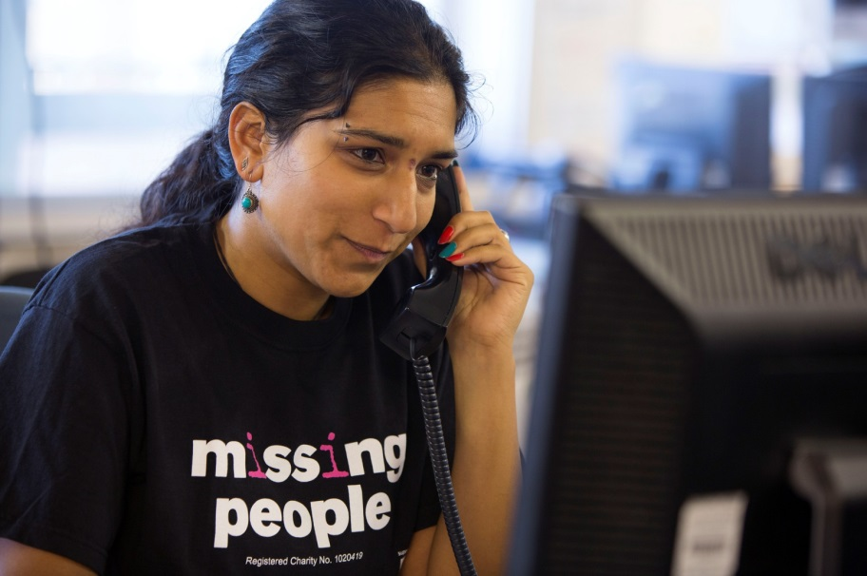
Stori Abi
Notes:
Abi is a 15 year old girl living in a small Welsh town.
She has been living with her Gran for 3 months since she fell out with her mother over her Mum’s new boyfriend.
After coming home very late one night Abi’s Gran was very annoyed that she hadn’t come home on time. After a heated row Abi ran away in the middle of the night and has since been staying with a friend.
When Gran found out that Abi had disappeared she firstly phoned everyone she could of to see if Abi was with them. Finally she was so worries she phoned the police to report that Abi had gone missing.
The Runaway helpline contacted Abi by sending a TextSafe message to let her know she could call the helpline for confidential support.
Reassured by the fact that the call was confidential Abi phoned the helpline.
Rima, the helpline worker, listened to Abi carefully and encouraged her to speak to a trusted adult about her problems.
Abi said she could chat with one of her teachers who had helped her before when her Dad left. Rima explained to Abi that until she was sure she was safe and well the police would need to continue looking for her.
Rima explained that if Abi was ready, Rima could stay on the line and connect Abi to the police without letting on where she was.
She reassured Abi that the service was confidential, and would not share any information about her without her permission – UNLESS THRER WERE SIGNIFICANT CONCERNS ABOUT HER SAFETY.
Abi agreed to do this and spoke to the Police on the phone. PC Jenny was very supportive and finally Abi told her where she was staying. PC Jenny said she would have to send some officers around to check that she was OK.
Rima promised that there would be someone to listen to her at any time if she needed further help or support.
Later that week, Abi saw the teacher who helped her to think through going back to Gran’s.
During the call
Abi called in to the Runaway helpline after receiving a Text Safe message from the charity.
A TextSafe message is a text that Runaway helpline can send to a missing person’s phone to let them know they can call the helpline for confidential support.
During the call, Abi explained that she was unhappy at home as a result of family arguments.
Then Runaway helpline listened carefully and advised Abi that if she felt able to tell someone about her situation, this might help her to get specific support. Abi said that she thought she could speak to her support worker at school.
The Runaway helpline explained that until they could be sure Abi was safe and well, the police would have to continue looking for her.
We asked if Abi would like to speak to the police herself, and that the charity could make a three-way call that wouldn't disclose her location.
We reassured Abi that the charity was a confidential service and wouldn't share information about her without her permission. UNLESS SHE WAS AT RISK
Abi agreed and was connected to the police officer, who was very supportive of Abi.
The police officer asked if she could tell him where she was and Abi gave the address of her friend's house where she had been staying.
The officer let Abi know that he'd ask some officers to attend the address as soon as they could to check she was okay.
We continued to support Abi after the three-way call ended and encouraged her to contact the charity at any time if she needed further help or support.

Slide 8
Ein gwaith
Llinell gymorth gyfrinachol am ddim 24/7
Gwrando ar yr hyn sydd gennych i’w ddweud, ni waeth faint sydd gennych i’w ddweud
Os ydych chi eisiau i ni wneud, byddwn ni’n gweithio ar eich rhan gyda’r heddlu neu’r gwasanaethau cymdeithasol
Os ydych chi eisiau i ni wneud, byddwn ni’n rhoi neges i’ch teulu

Slide 9
Cymorth drwy neges destun
Chi sy’n ein harwain. Byddwn ni ddim yn dweud wrthych beth i’w wneud.
Rydyn ni’n rhoi cyngor yn seiliedig ar eich sefyllfa unigol.
Chi sy’n penderfynu beth rydych chi’n ei wneud ac i ble yr ewch.
Ein pryder pennaf yw diogelwch y galwr.
Notes:
??? How is the caller’s safety established This slide may need to be altered.

Slide 10
Cymorth i Deuluoedd
Notes:
The Runaway helpline has a service that will also support families when someone goes missing.
If a friend or relative disappears you can call us at any time for practical advice or support.

Slide 11
Beth allwch chi wneud
Rhoi 116000 yn eich ffôn heddiw rhag ofn y bydd byth angen i chi gysylltu â ni
Ein dilyn ni ar Facebook
a Twitter
Os ydych chi’n adnabod rhywun sy’n ystyried rhedeg i ffwrdd, anogwch nhw i’n ffonio ni
Galwch heibio i’n gwefan am ragor o wybodaeth amdanom: www.missingpeople.org.uk
Notes:
Add schoolbeat.org to slide
MEIC advocacy and helpline?

