Slide 1
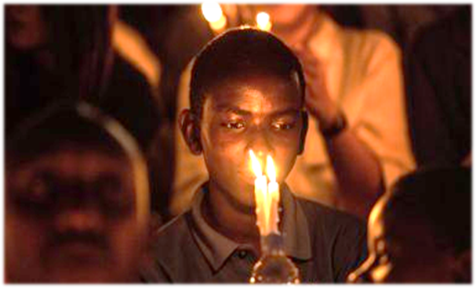
Holocaust Memorial Day
January 27th, 2024
We promote and support Holocaust Memorial Day on 27th January to remember the six million Jews murdered during the Holocaust, alongside the millions of other people killed under Nazi persecution of other groups and in genocides that followed in Cambodia, Rwanda, Bosnia and Darfur.
This year the theme is:
The Fragility of Freedom.
In every genocide that has taken place, those who are targeted for persecution have had their freedom restricted and removed, before many of them are murdered.
If we all work together to stop discrimination and prejudice, then we hope that freedom for all will be achieved, and all genocides will end. HMD-2024-Theme-Vision.pdf

