Slide 1

The ‘uh oh’ feeling!!

Slide 2
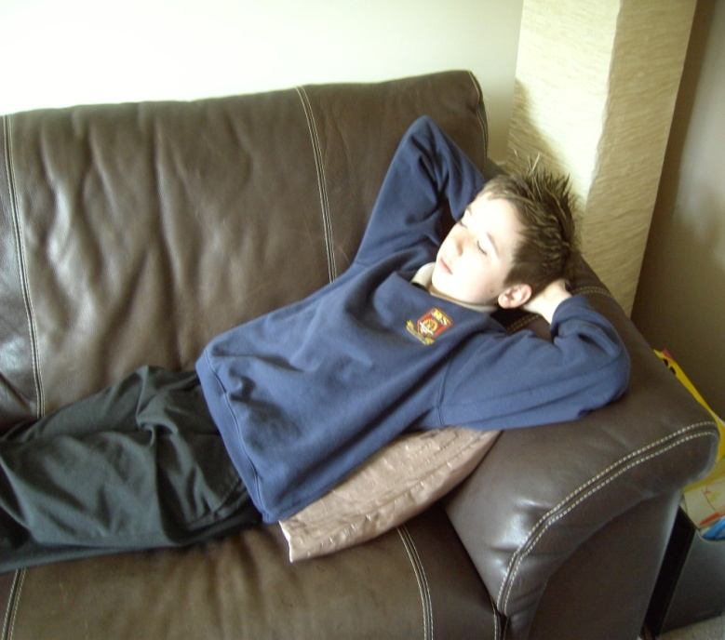
Home alone when
a stranger calls
What a day!
Joseph had just arrived
home from school and
was enjoying a few
moments to himself
Wonder what’s for dinner?

Slide 3

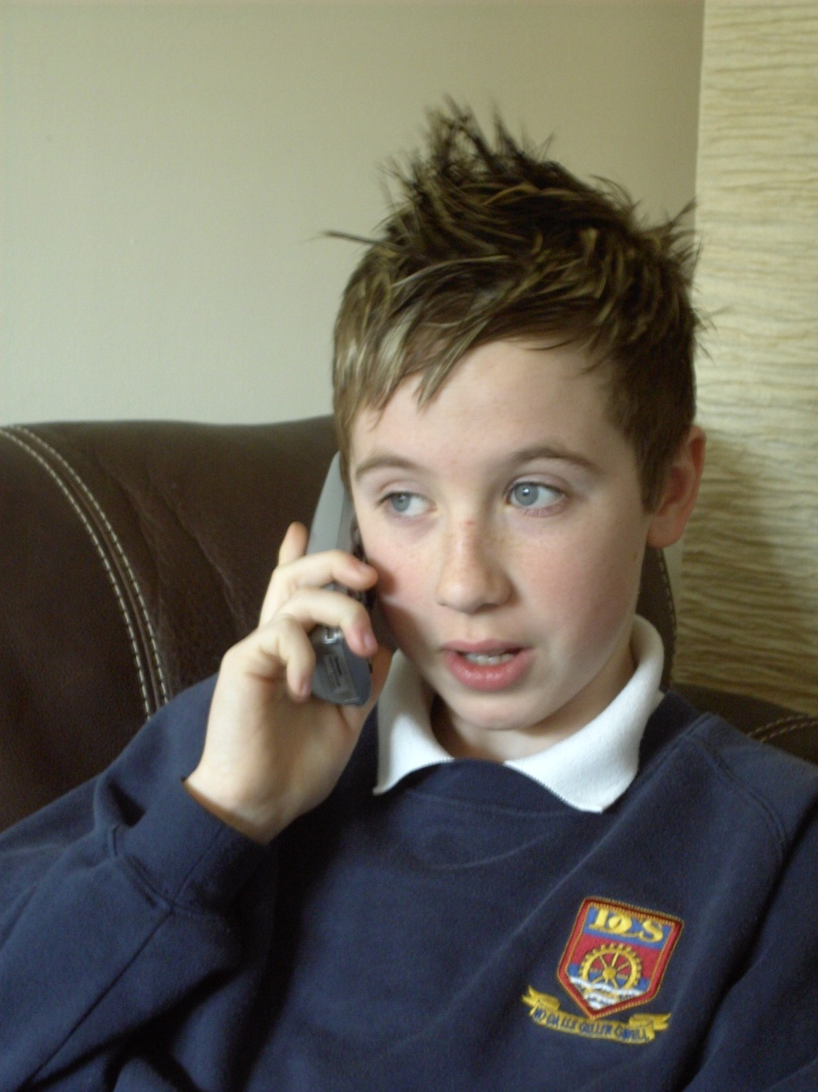
Hello.
Joseph speaking

Slide 4
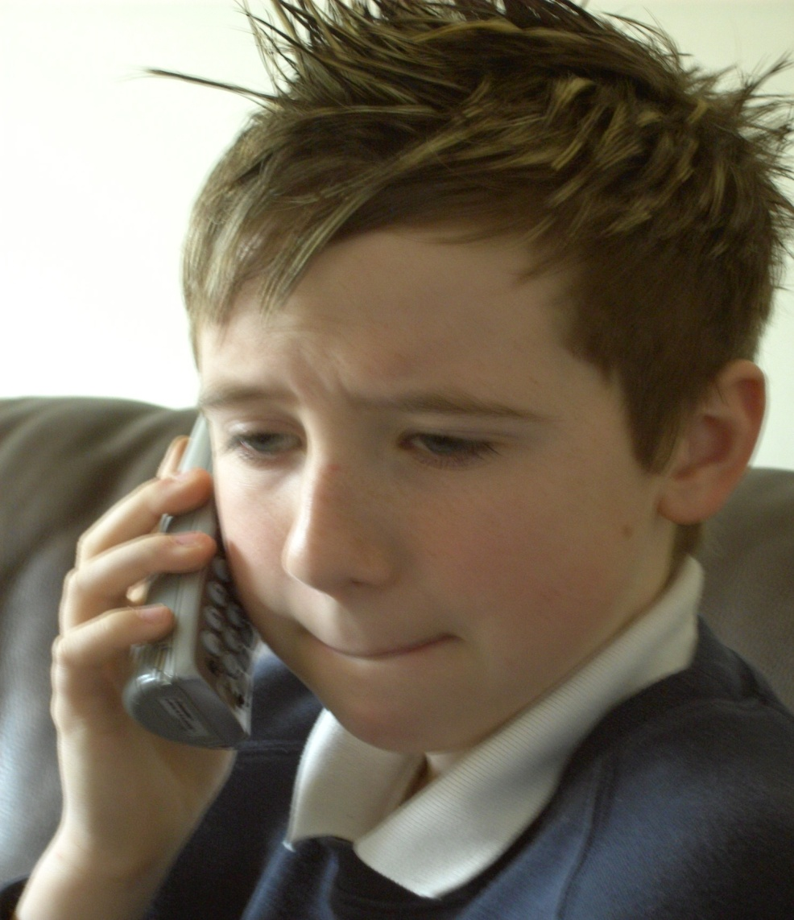
Hi, are your
parents home?
No. Not yet
When will they be home?
In about an hour
Your dad asked me to fix the lock on the back door.
Ok.

Slide 5
Joseph began to feel uneasy

Slide 6
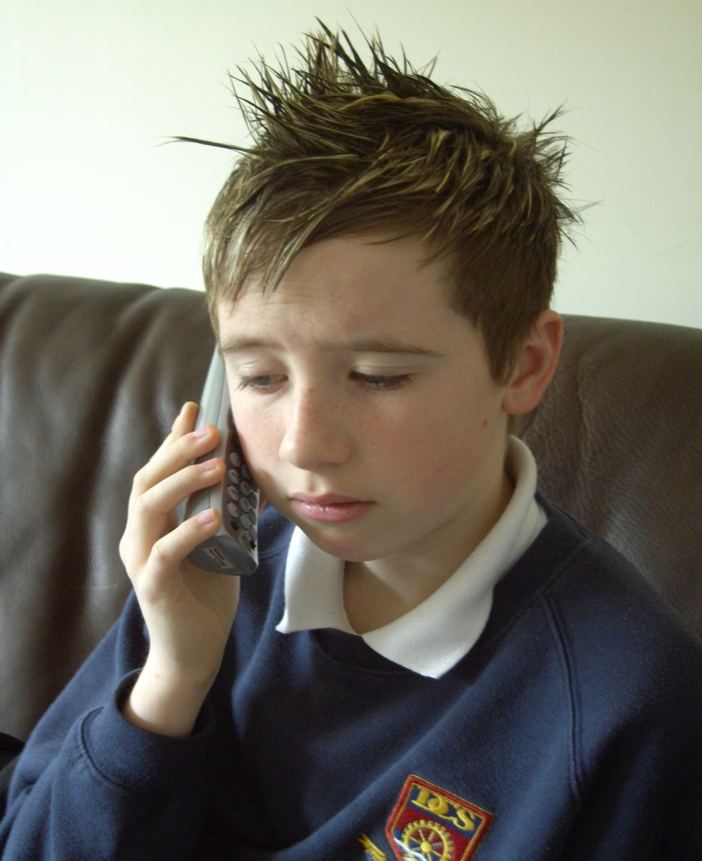
I can come and do it now. That is Ryan isn’t it?
Ok then.
No, it is Joseph.
Remind me where you live again?
16 Lake View.
Behind the park
See you in
15 minutes

Slide 7
What do you think might happen next?
?

Slide 8
Points for discussion
What could Joseph have done better to keep himself safe?
What would you have said?
What did Joseph do right?
What did Joseph do wrong?
How would you have felt in that situation?

Slide 9
Answering the
door
Close the door and go to tell your mum
Never let anyone in who you do not know or trust
Notes:
9
9

