Slide 1
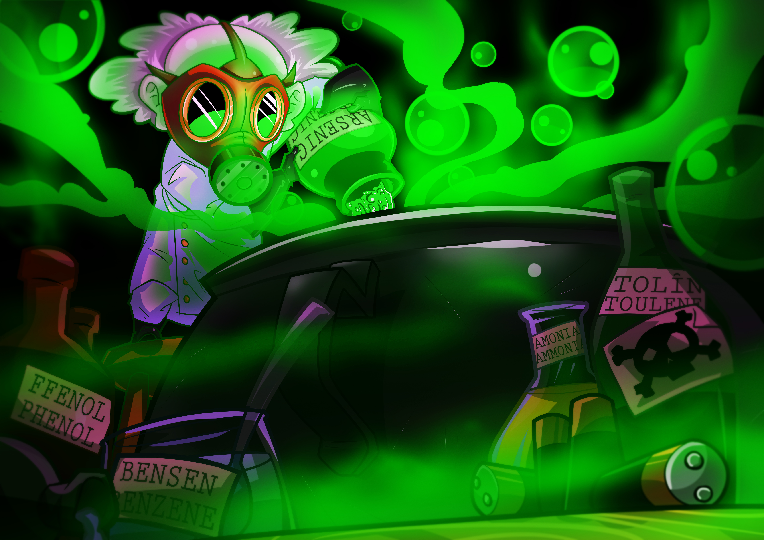
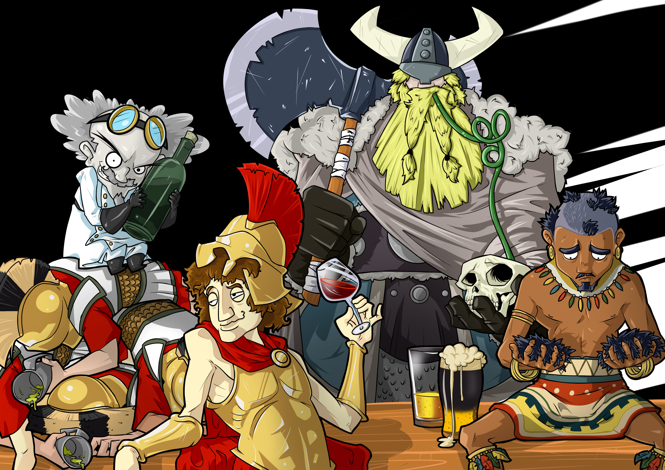
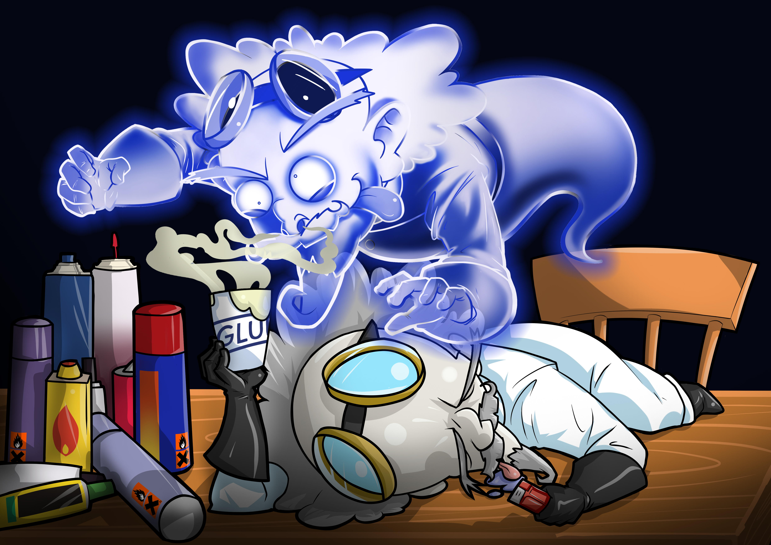
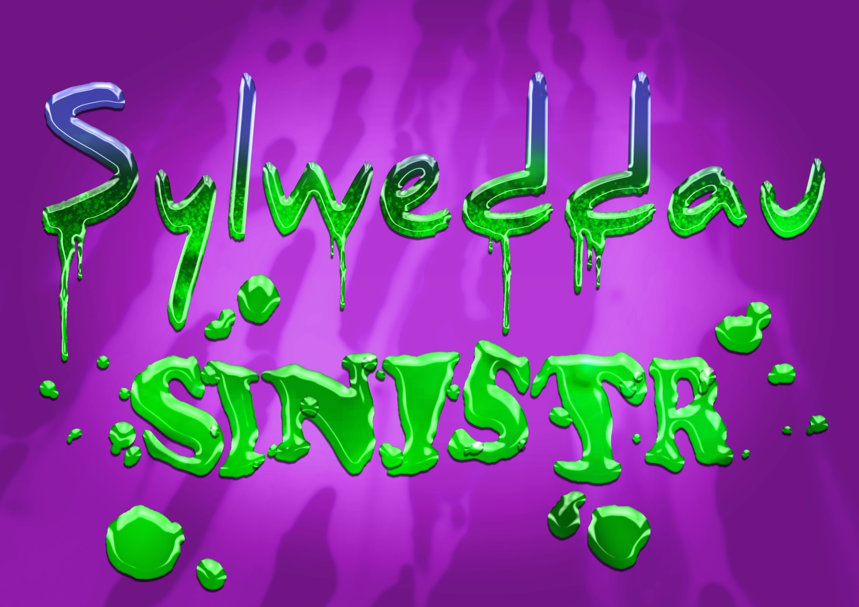
Adnodd 4 / Resource 4
Mae Sylweddau Sinistr o’n cwmpas bob dydd, Cofiwch fod yn ofalus os y gwelwch nhw’n rhydd! Tybaco, Alcohol a Thoddyddion – y tri Mae nhw’n wenwynau all oglyu peryglon di-ri!

Slide 2
We see these Sinister Substances every day,
Remember to take care when they come your way!
Tobacco, Alcohol and Solvents too,
All three are poisons which can be dangerous to you!

