Slide 1
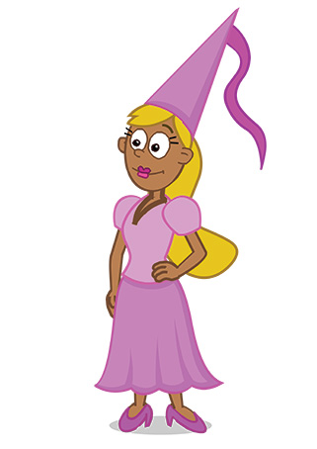
6b.Avatar / Profile
Profile: Pink_Princess
?
Who could it be in real life?

