Slide 1
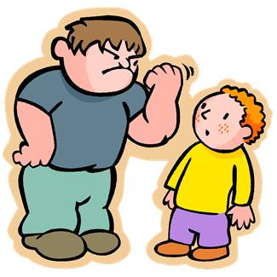
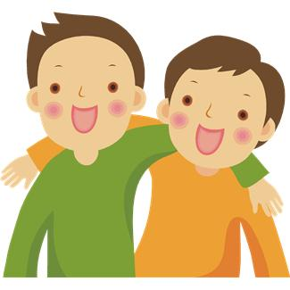
The role of the bystander
Bullying
Activity 4

Slide 2
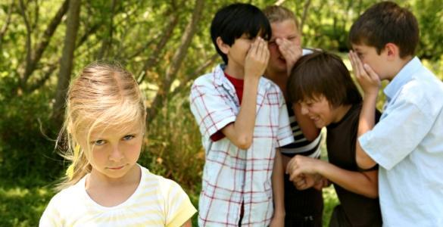
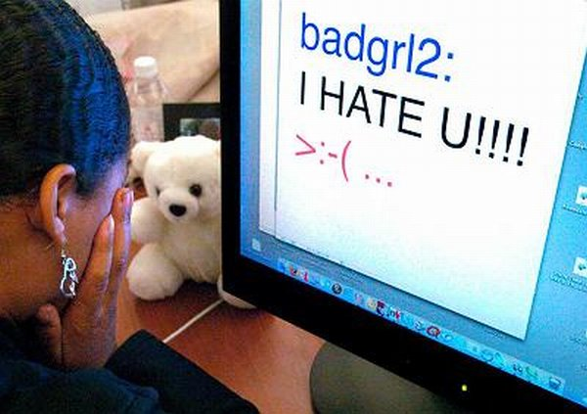
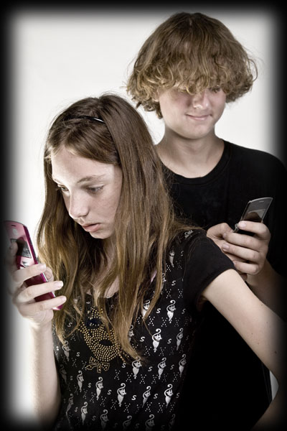
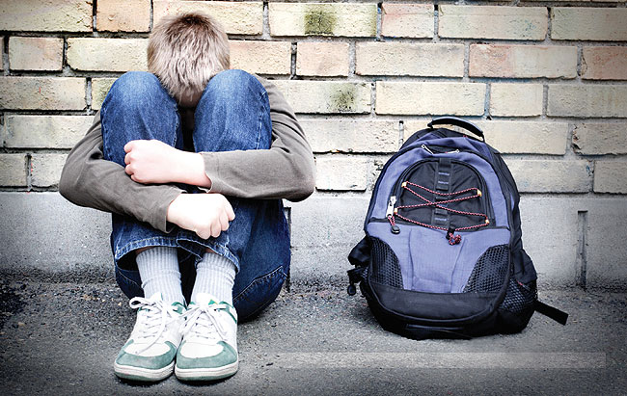
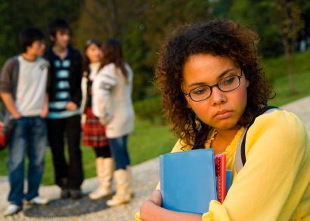
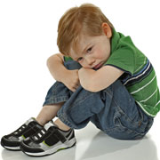
Bullying is when someone, on purpose, hurts, threatens or frightens you regularly
What is bullying?

Slide 3
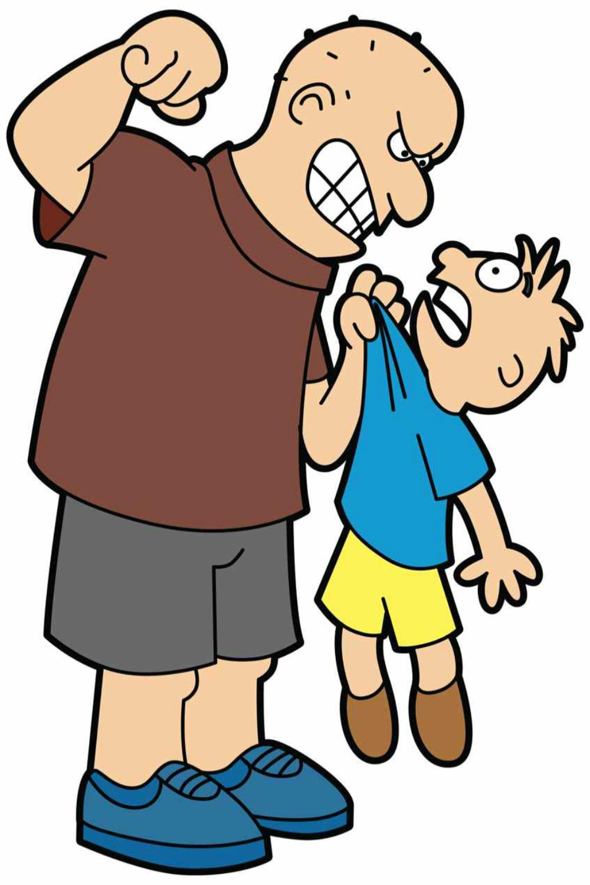
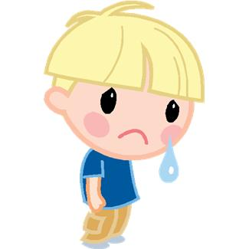
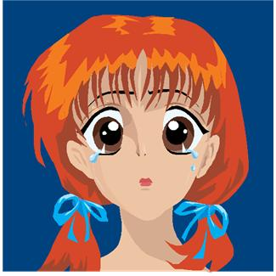
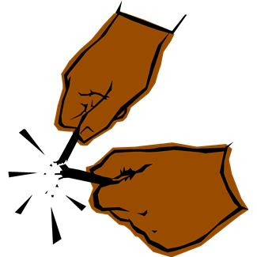
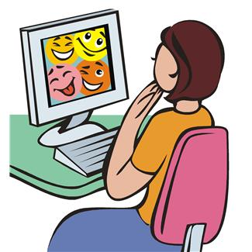
What types of bullying
do you know about?
hurting someone
name calling
being left out
taking things from others
making signs
cyberbullying

Slide 4
What is a bystander?
an onlooker
a witness
an observer

Slide 5
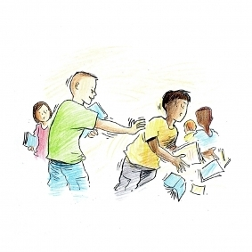
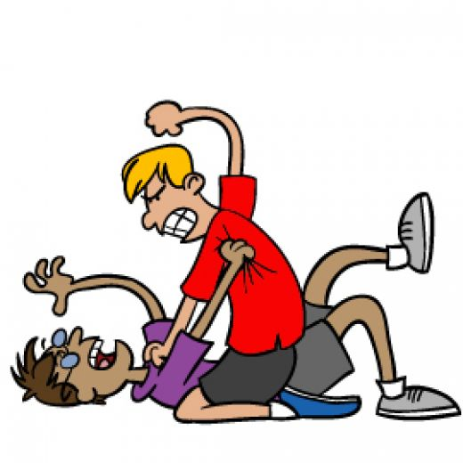
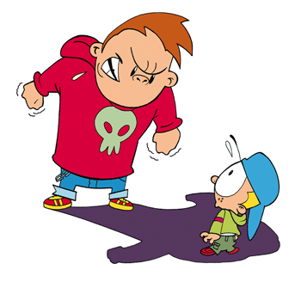
Would you help?
In pairs talk about when
you would and when you wouldn't help
someone being bullied

Slide 6
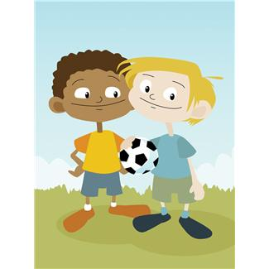
Can you finish the sentences?
I would not help someone who was being bullied if…..
I would help someone who was being bullied if…..

Slide 7
What could you do?
Put the statements in order
Most likely - First
Least likely - Last

Slide 8
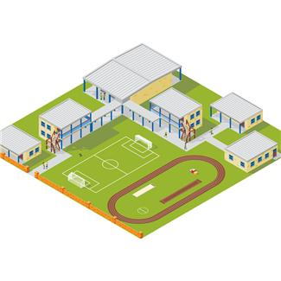
Where in school have you seen
bullying happen?

Slide 9
Did you know?
In the playground children help stop bullying more often than adults!
Bystanders are present nearly every time bullying happens. (8/10)
Bullying will stop in under 10 seconds when peers (other children) help

