Slide 1
Internet safety
What would you do?

Slide 2
Questions
by young people of
your age

Slide 3
“I met Sam in an internet chatroom, we have been in contact for a few weeks. He wants to meet.” Jillian, age 12 What do you think?
Meet up, you get on well
I would take my friend with me to the meeting
Don’t meet up, but there is no harm in chatting
Tell your mother where and when you meet and take her with you
Bad advice
dangerous situation
Bad advice
putting two at risk
Good advice
keep online friendship online
Good advice
meet with an adult in public

Slide 4
“Gwyn has asked for my phone number and e.mail address, we have been in contact for a few weeks, we get on really well we are Man U fans.” Ian, age 11 What should I do?
This is a good idea
Continue to chat but do not give personal details
Stop chatting immediately
Continue to chat and discuss with a trusted adult
Bad advice
dangerous to give personal details
Good advice
never give details
Good advice
if you feel uncomfortable
Good advice
talk to an adult

Slide 5
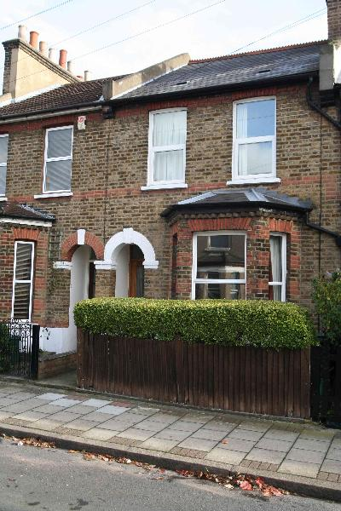
“Sarah has asked for my home address, we have been friends on the internet for months. She wants to visit my home. Janet, age 13 What should I do?
Bad advice
dangerous to give personal details
Good advice
never give details
Good advice
if you feel uncomfortable
Good advice
talk to an adult
This is a good idea
Continue to chat but do not give personal details
Stop chatting immediately
Continue to chat and discuss with a trusted adult

Slide 6
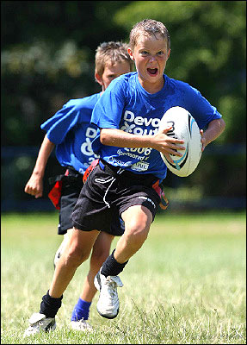
Jack sent me a photo of him playing rugby. He wants a photo of me. Sian age 12 What should I do?
This is a good idea
Don’t send photo tell an adult
Don’t sent but carry on chatting
Send only a photo of her face
Bad advice
looses control of photo
Good choice
tell a trusted adult when worried
Good advice
keep in control
Bad advice
looses control of photo

Slide 7
“Because I refused to meet with Gary my chatroom “friend”. Now he is threatening to write nasty things about me Lowri, age 11 What should I do?
Don’t tell anyone else
Save the message and report it
Agree to meet , to stop him carrying out his threat
Talk to a trusted adult
Bad advice
threatening someone against the law
Good advice
report to police
Bad advice
threatening someone is against the law report to police
Good advice
talk to trusted adult if worried

Slide 8
For the past month some people on my MSN contact list are always writing nasty and horrible things about me. Imran, age 12 What should I do?
Keep it to yourself, ignore them
Save the messages and report them
Stop chatting immediately
Talk to a trusted adult
Bad advice
always tell when you are bullied
Good advice
report to police or talk to Childline
Good advice
if you feel uncomfortable
Good advice
talk to trusted adult if worried

Slide 9
Did you offer good advice?

