Slide 1
The All Wales School Liaison Core Programme
Crime Prevention and Keeping Safe
Social and Legal Aspects of Personal Safety
Level 1 & Level 2
Key Stage 3
Supporting PowerPoint for the teacher lessons

Slide 2
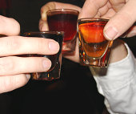
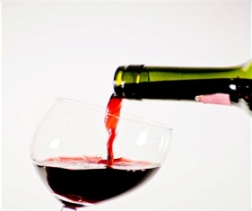
Define a unit of Alcohol
One unit is 10 ml of pure Alcohol.
One unit of Alcohol is about equal to:
half a pint of ordinary strength beer, lager or cider (3-4% alcohol by volume);
a small pub measure (25 ml) of spirits (40% alcohol by volume);
a standard pub measure (50 ml) of fortified wine such as sherry or port (20% alcohol by volume).
AC1.

Slide 4
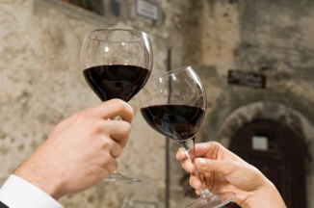
L1. State three laws about alcohol use L2. State three laws about alcohol use
At you can drink beer, wine or cider with a meal accompanied and bought by an adult.
is the legal age to buy alcohol.
It is illegal to give alcohol to someone under years of age.
Police have powers to confiscate alcohol from young people below years of age
Police can use a order to stop youths gathering.
AC1.1

Slide 11
Anti-social behaviour is........
any behaviour that you think is wrong, upsets someone or is against
the law.
AC3.

Slide 12
AC3.

Slide 13
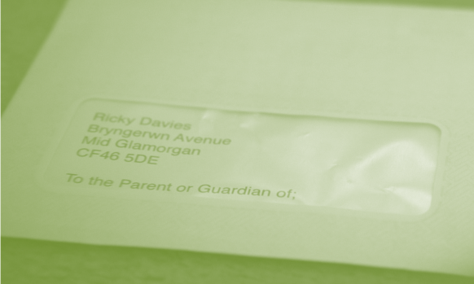
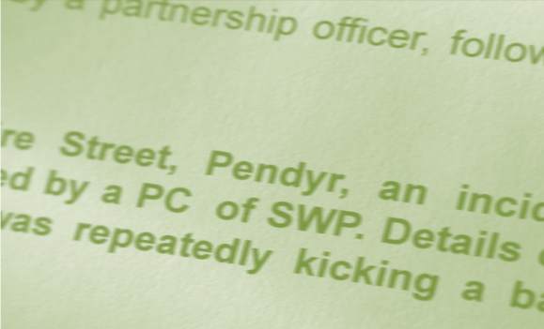
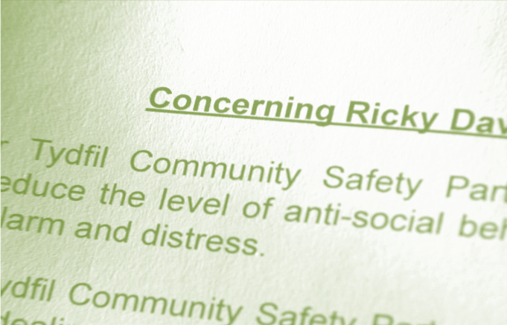
L1. Identify the legal process as a consequence of ASB L2. Describe the legal process as a consequence of ASB
Which is the correct order?
Warning letter
Anti-Social Behaviour Order
Acceptable Behaviour
Contract
Second ASB letter to parents.
AC3.2

Slide 18
Domestic abuse is……………………
any incident involving someone 16 or over which is abusive, violent, threatening, controlling or harmful by an intimate partner or family member, regardless of gender or sexuality.
AC5.

