Slide 1
(4b) Legal/Illegal Activities

Slide 2
Internet
research

Slide 3
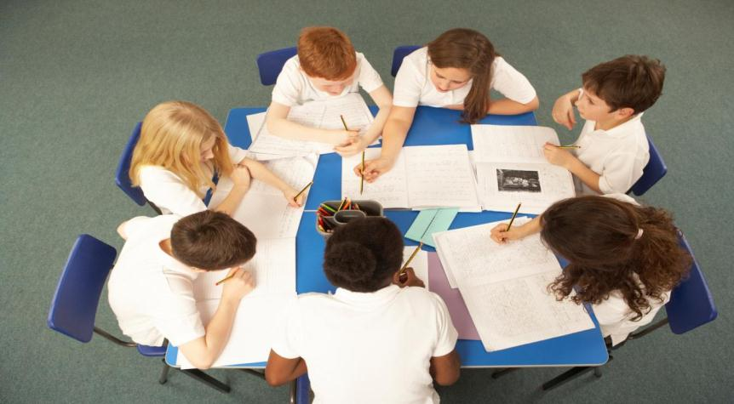
School Council

Slide 4
Debate/Meeting

Slide 5
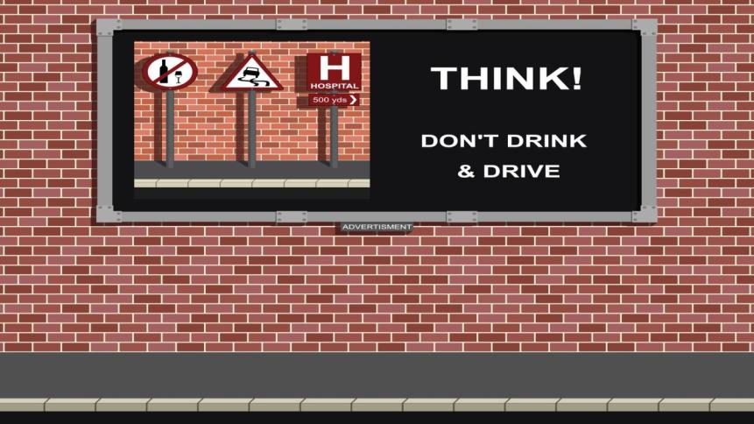
Poster campaign

Slide 6
Write an article for the press

Slide 7
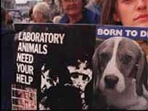
Peaceful demonstration

Slide 8
Silence campaign

Slide 9
Promotional
materials

Slide 10
Signing a petition

Slide 11
Write a letter to your M.P.
Mr. David Matthews, A.M.
Welsh Assembly Government
Cathays Park Cardiff CF10 3NQ

Slide 12
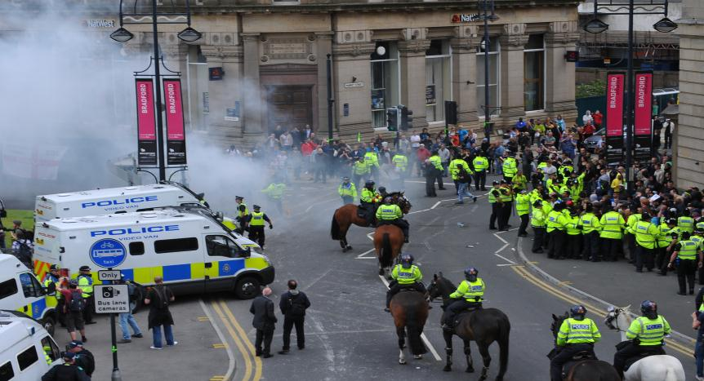
Non-peaceful demonstration

Slide 13
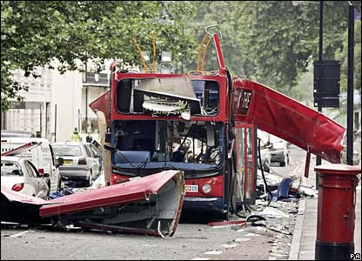
Bombing/Terrorism

Slide 14
Blocking the road

Slide 15
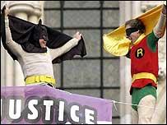
Climbing buildings

Slide 16
Graffiti

Slide 17
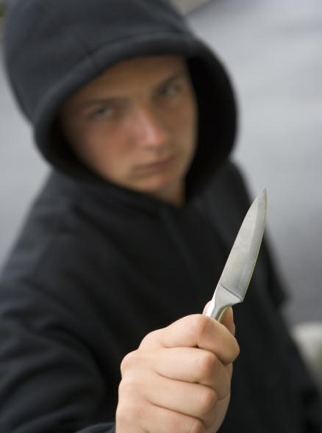
Threatening
behaviour

Slide 18
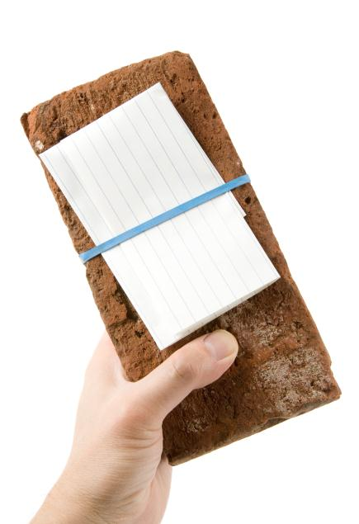
Threatening
letter
Pakistani
go home

Slide 19
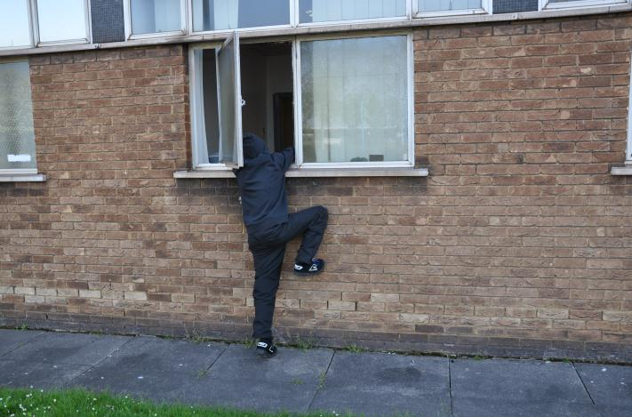
Burglary

Slide 20
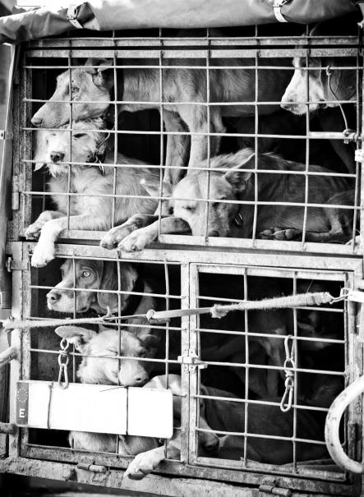
Releasing
captive
animals

Slide 21
Bombarding a website to attempt to shut it down

