Slide 1
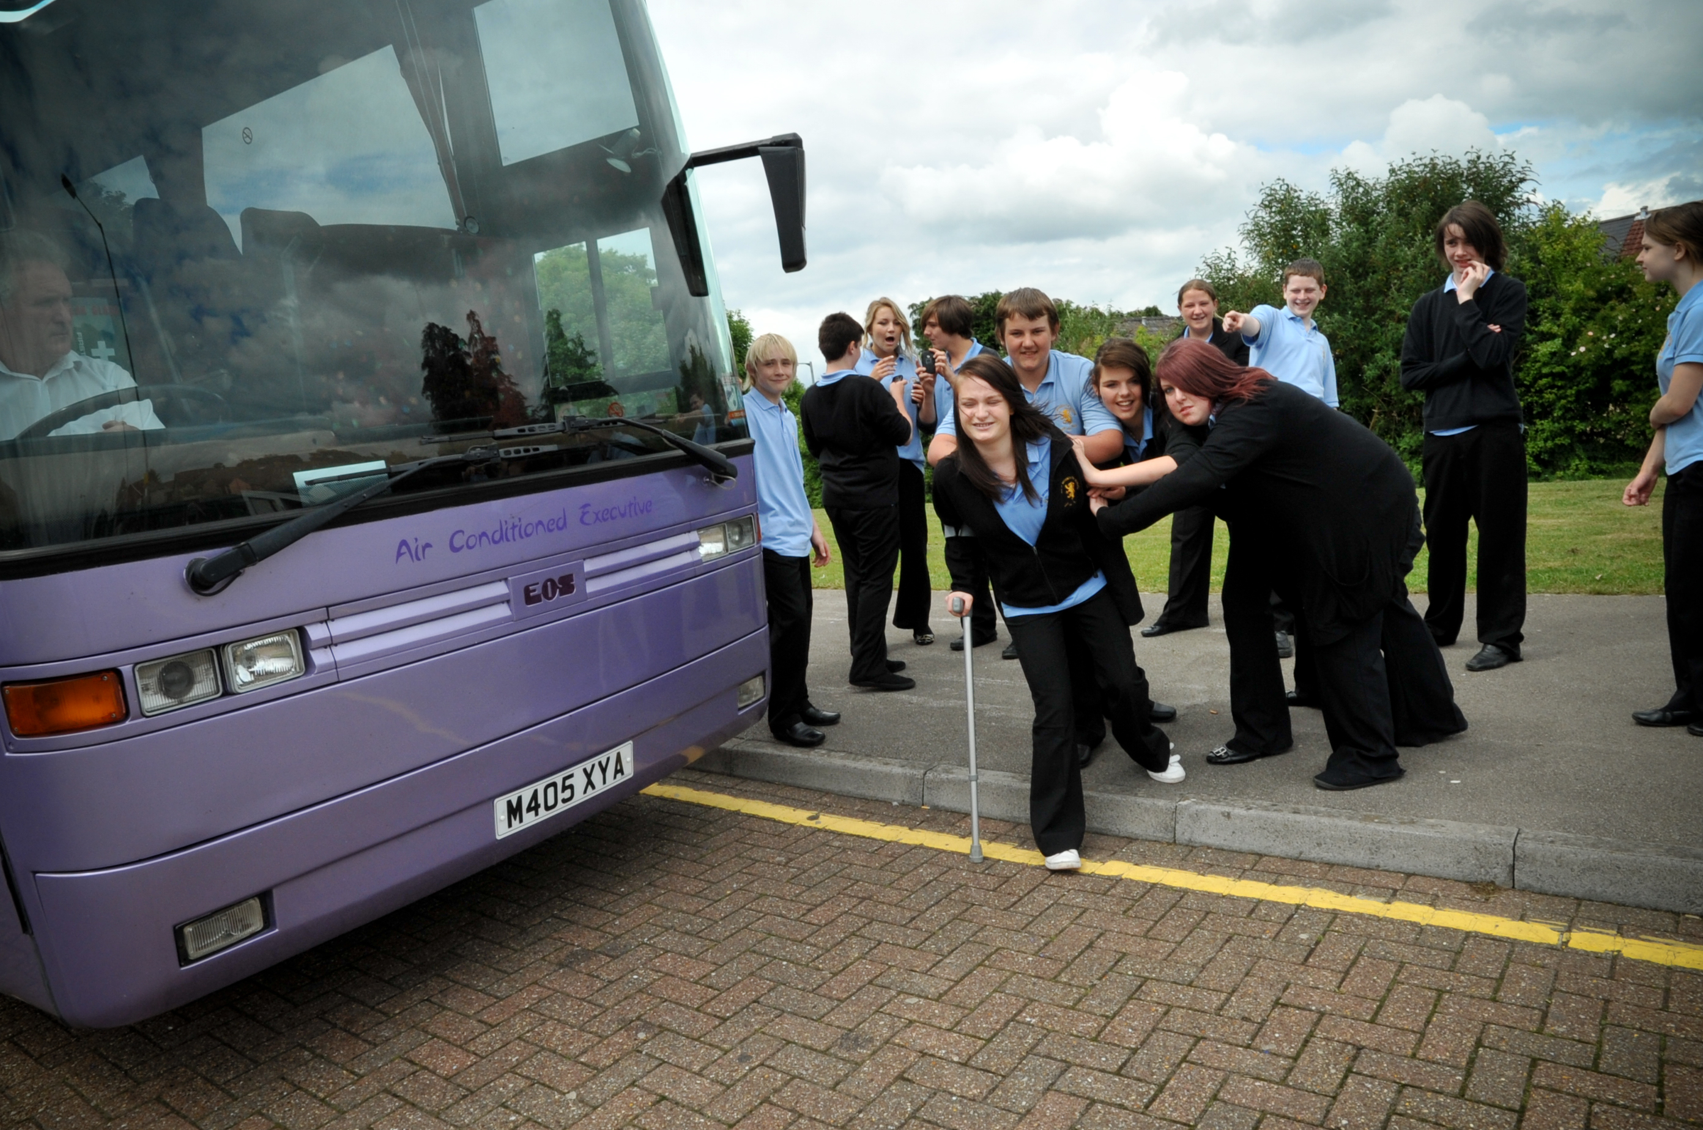
© Copyright of Gwent Police © Hawlfraint Heddlu Gwent

Slide 2
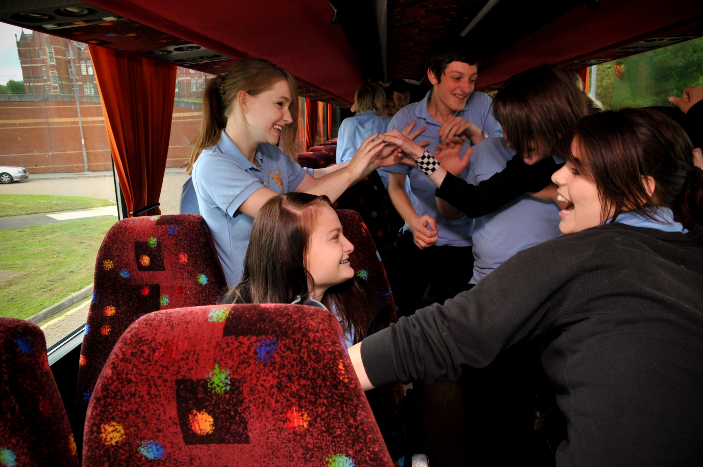
© Copyright of Gwent Police © Hawlfraint Heddlu Gwent

Slide 3
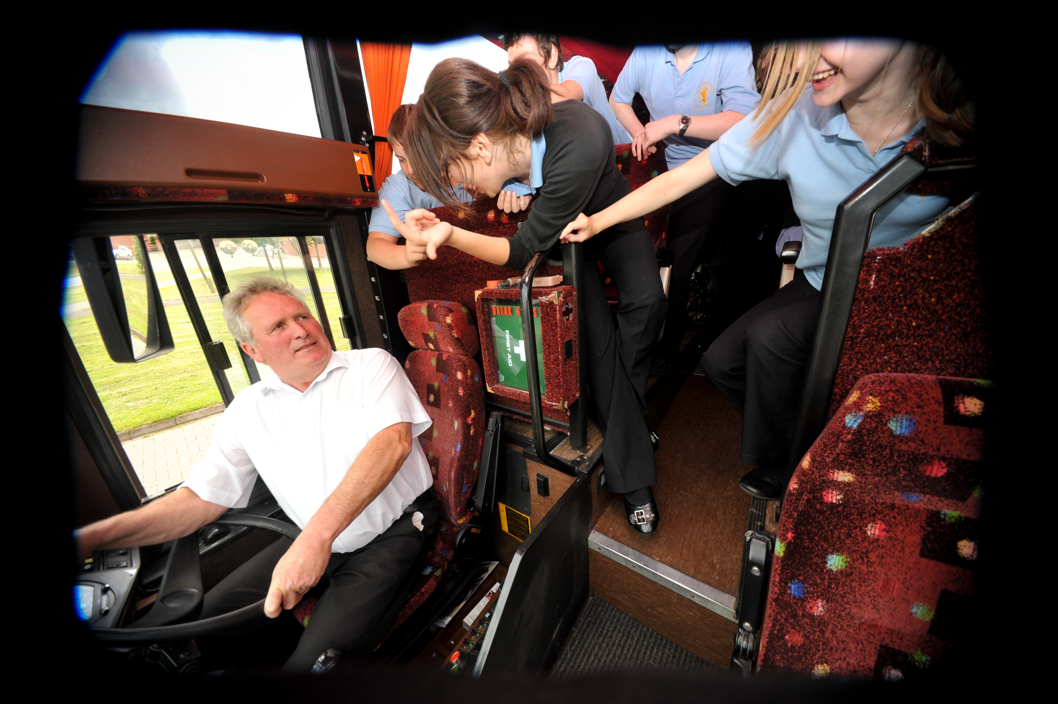
© Copyright of Gwent Police © Hawlfraint Heddlu Gwent

Slide 4
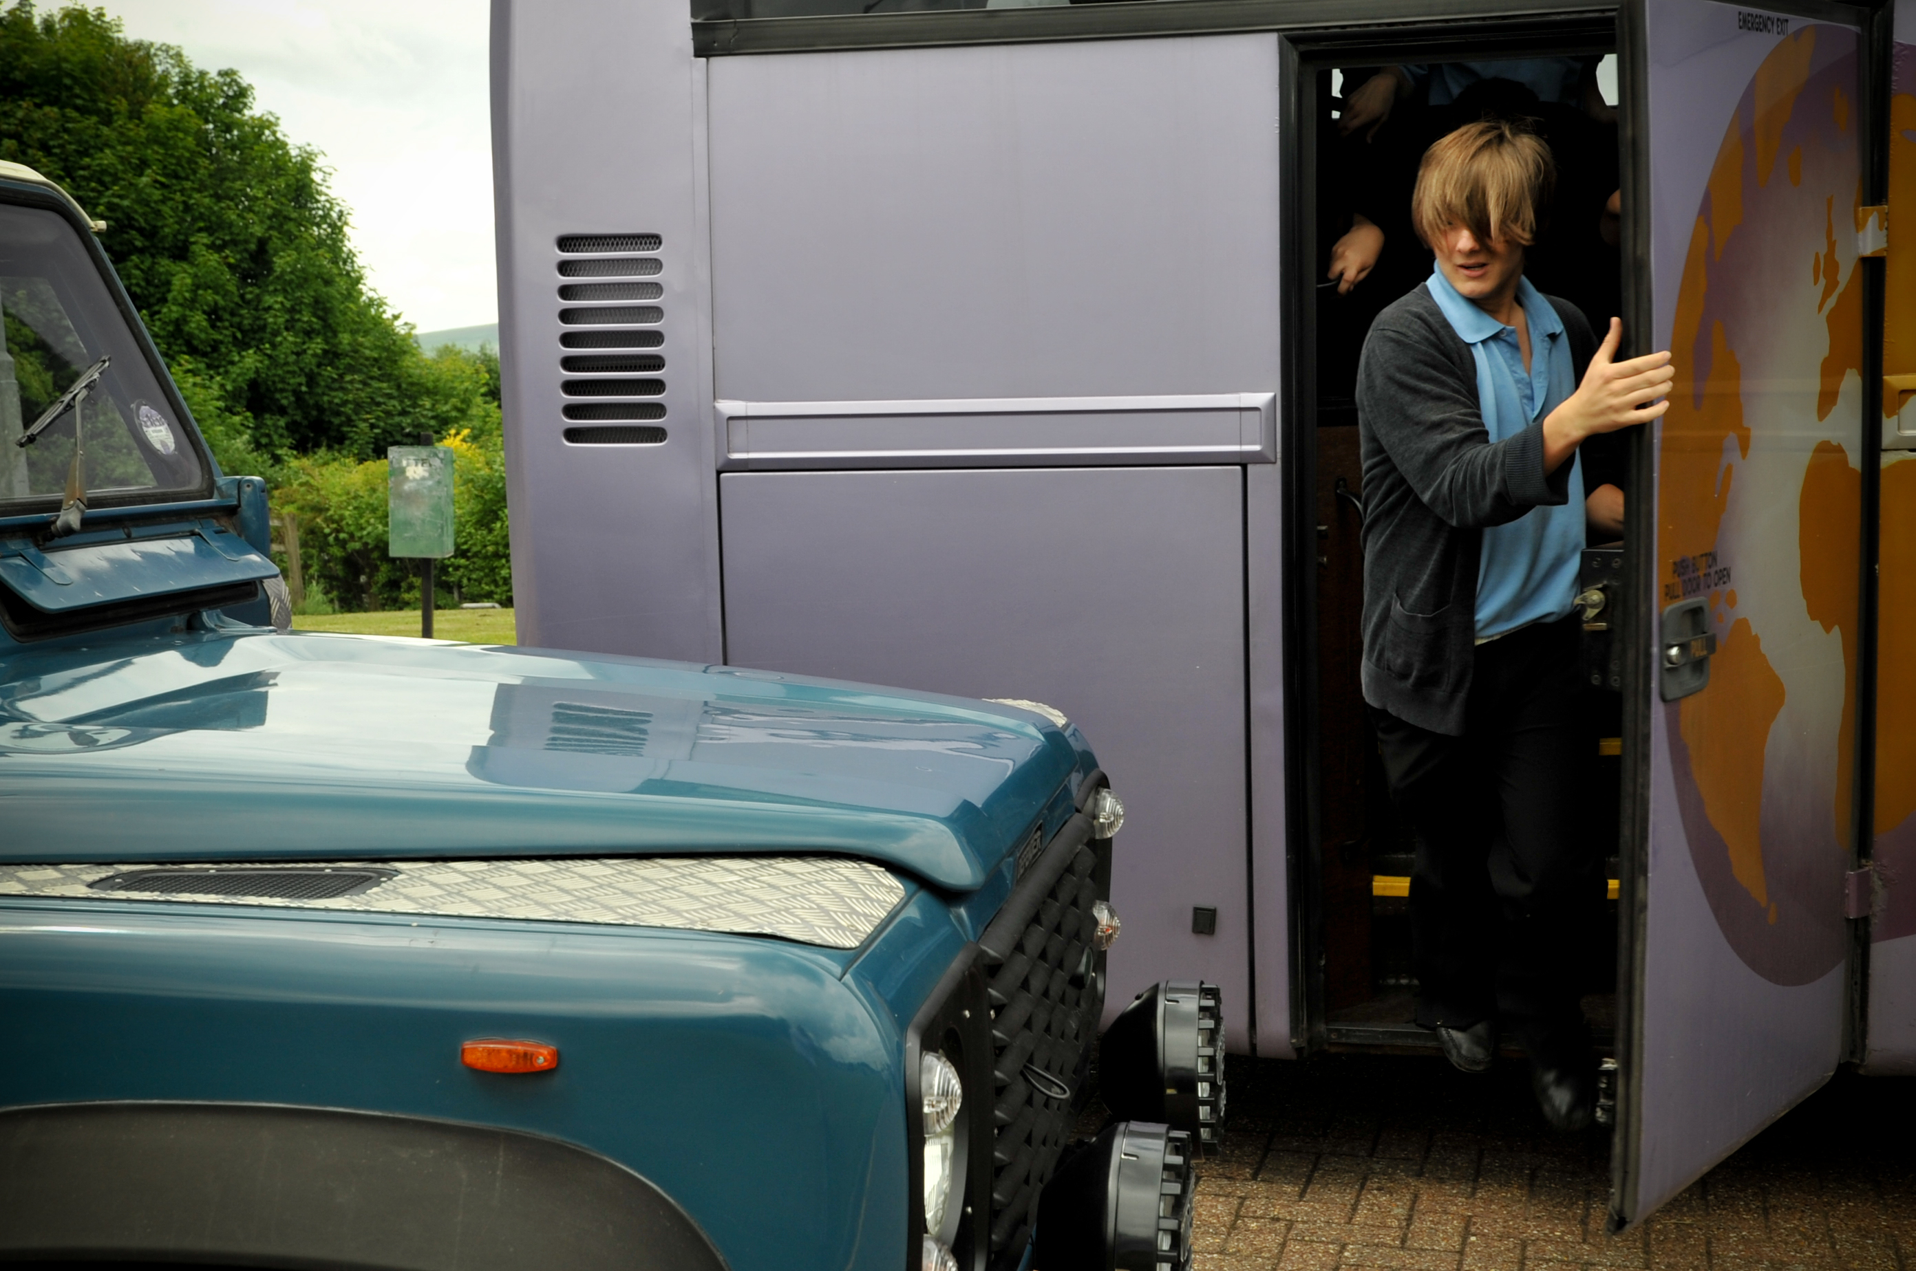
© Copyright of Gwent Police © Hawlfraint Heddlu Gwent

Slide 5
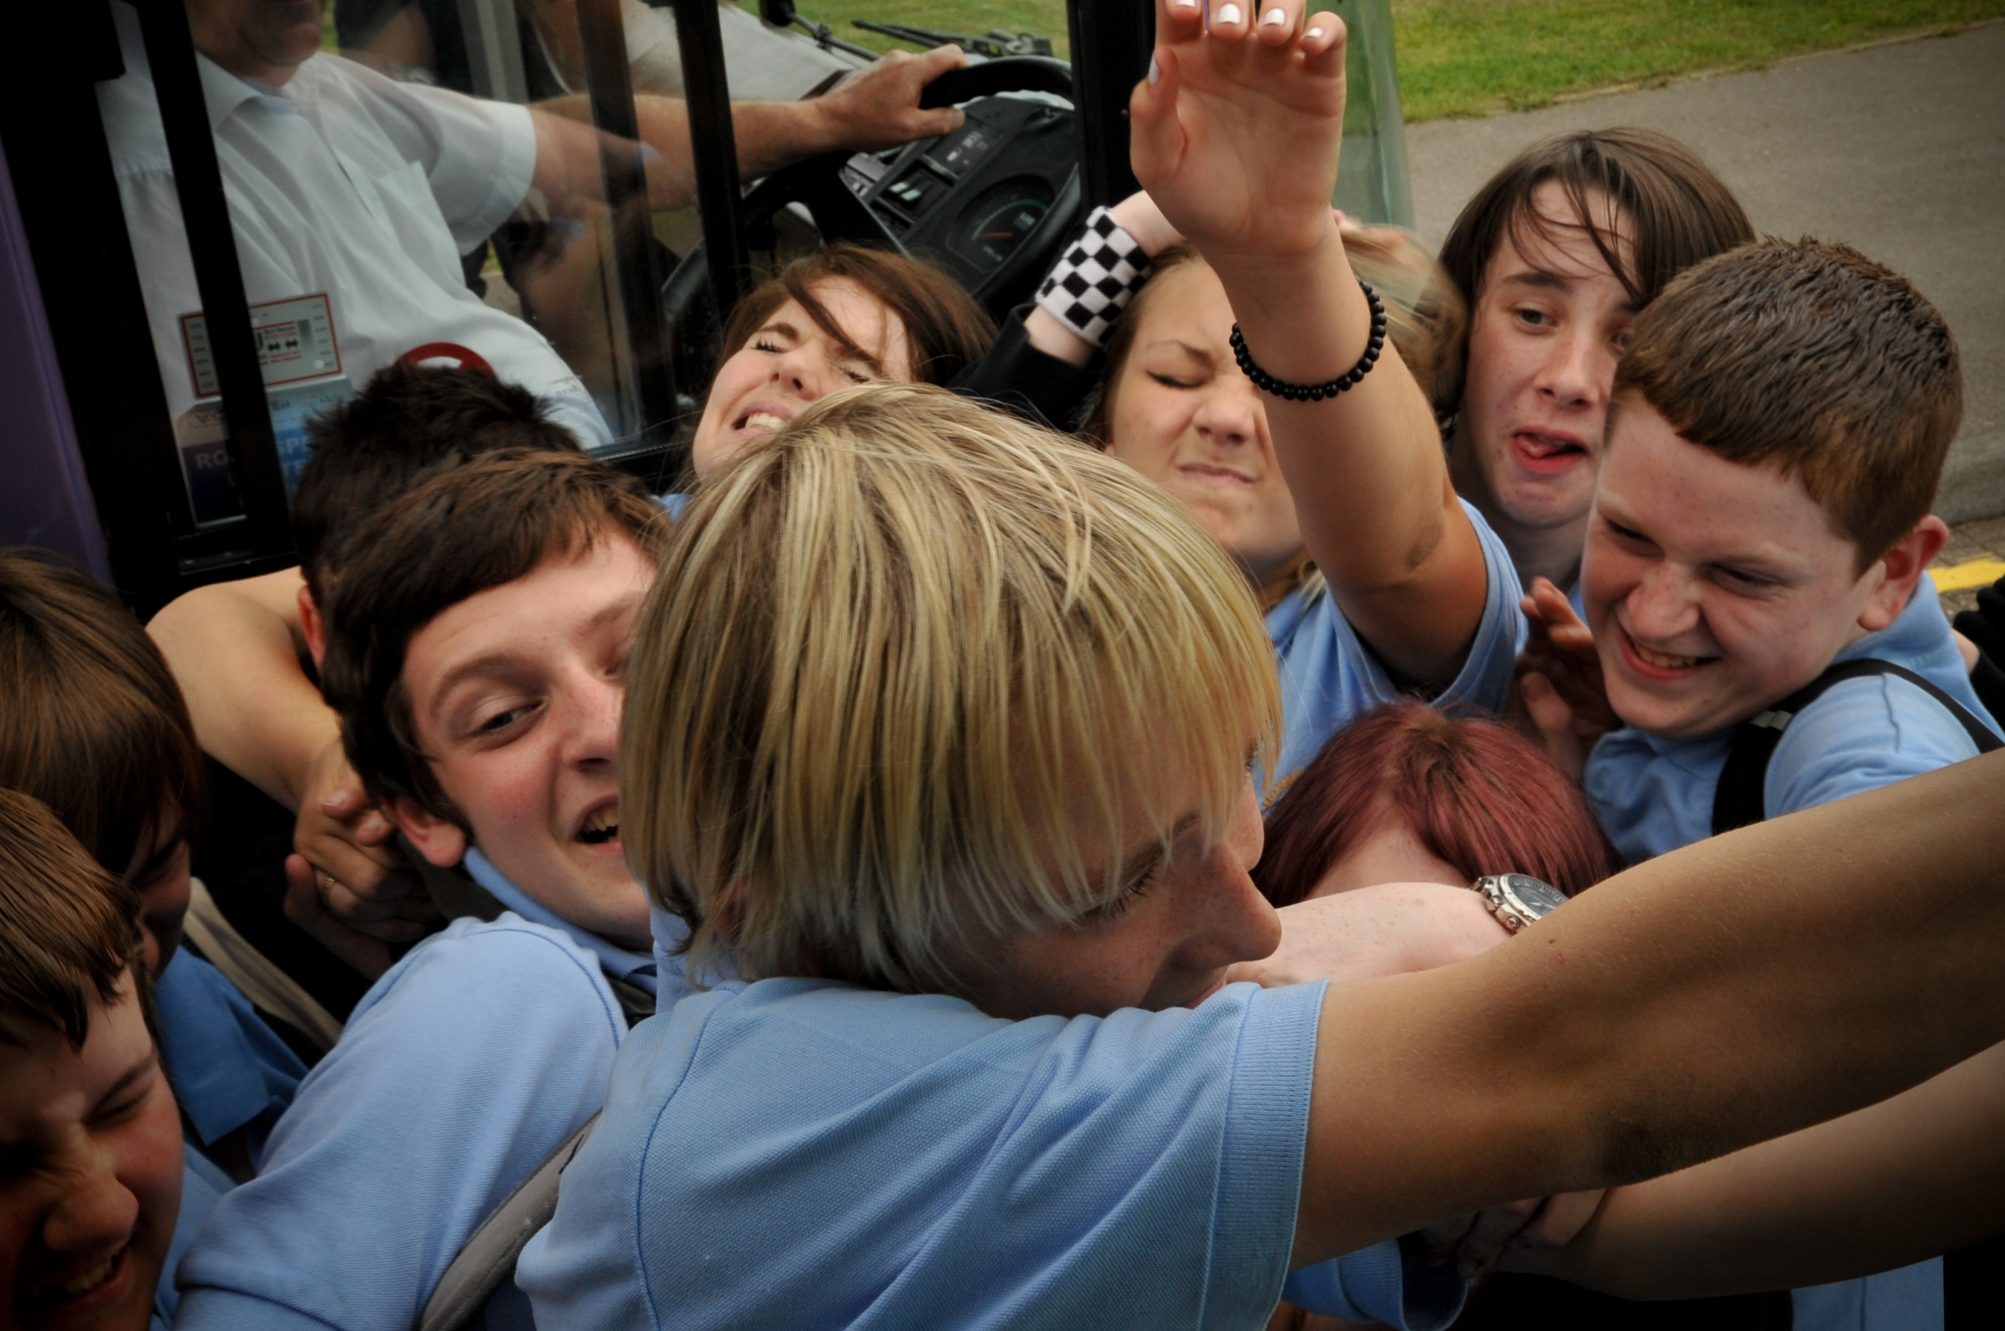
© Copyright of Gwent Police © Hawlfraint Heddlu Gwent

Slide 6
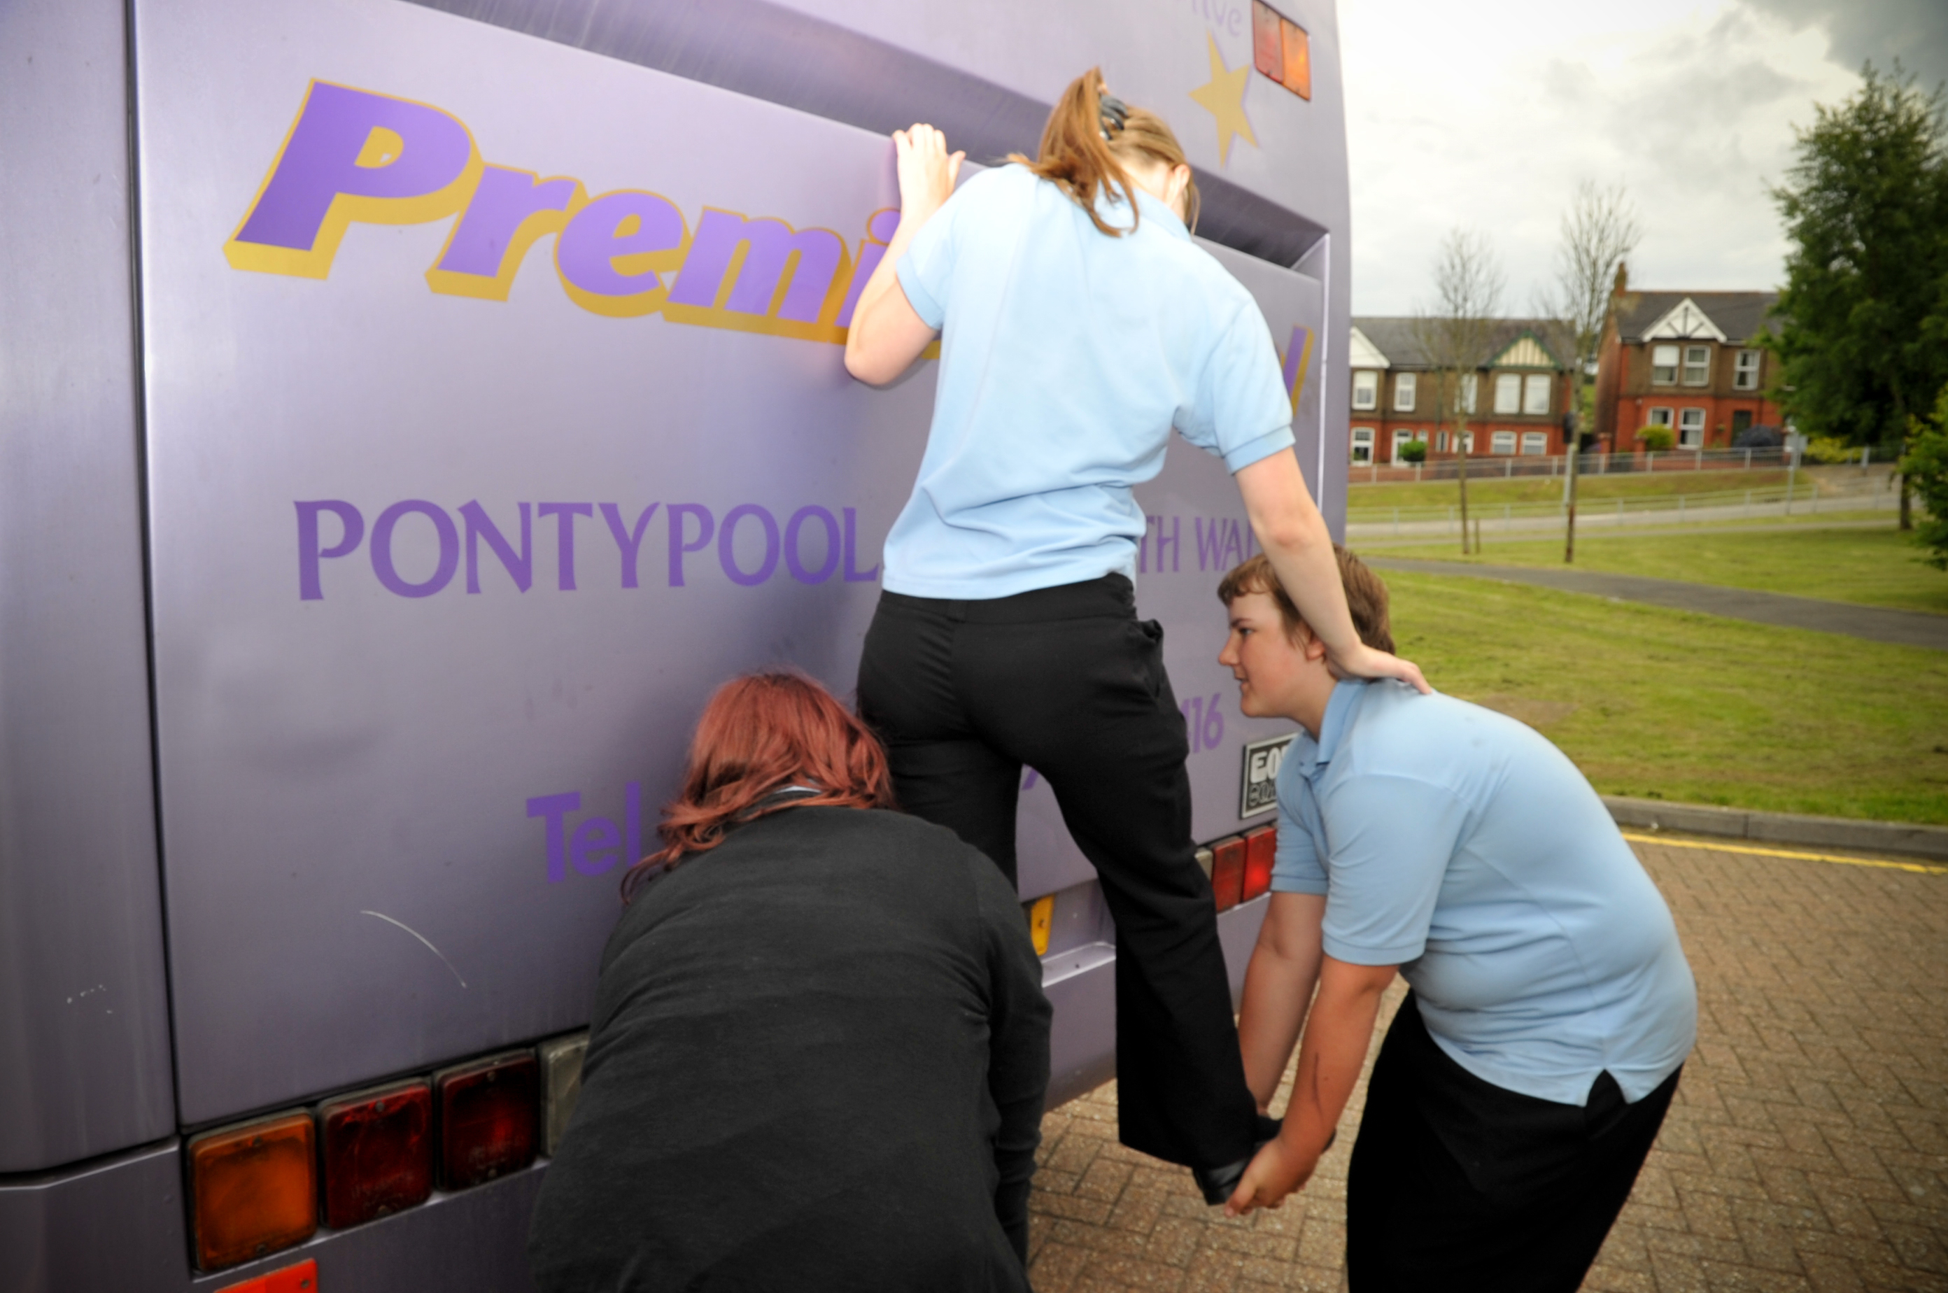
© Copyright of Gwent Police © Hawlfraint Heddlu Gwent

