Slide 1
Resource 4a.
Who am I?
How do you know?

Slide 2
Remember, an online friend we don’t know in the real world, is still a
S
t
r
a
n
g
e
r

Slide 3
Tom’s Story
schoolbeat.org/youtube/toms-story

Slide 4
Stop and think
What did Tom do to put himself at risk?
Why did he feel he couldn’t tell anyone?
What could he have done differently?
How can Tom reduce his risk online and in the real world in the future

Slide 5
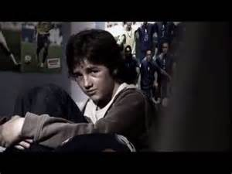
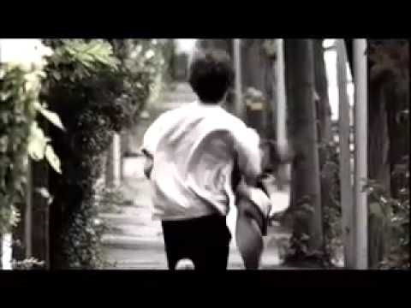
What happened to Tom has a name, it is called…
…grooming

Slide 6
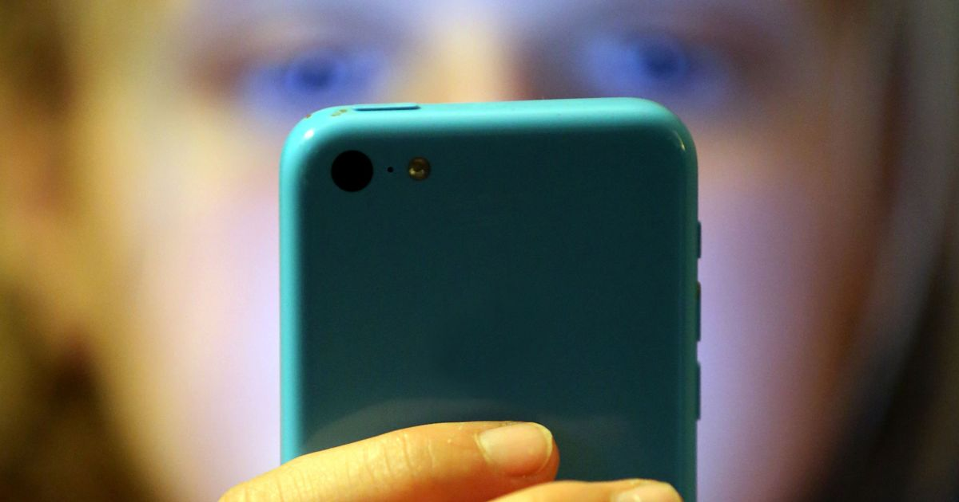
Definition
Grooming is the way in which an adult deliberately befriends a young person and gains their trust so that they can sexually harm them.
Groomers can be young or old and any sex.

Slide 7
What is sexual harm?
Starting up sexual conversations
Asking for naked pictures or videos
Asking for you to do something sexual on a webcam
Sending you naked pictures or videos
Asking to meet you in person
(Under 18)

Slide 8
Real world
Maintain control
Sexualise the relationship
This warning triangle shows the stages of grooming. Can you identify how these things happened to Tom in the film? Let’s look at the first section again. Write down your ideas in the spaces on the left hand side.
Isolate the young person
Develop a friendship
Gain trust
Befriend the young person
Stages of grooming and CSE

Slide 9
Real world
Maintain control
Look at the warning triangle again. How could the stages of grooming happen in Real Life? Write down your ideas in the spaces on the right hand side.
Sexualise the relationship
Isolate the young person
Develop a friendship
Gain trust
Befriend the young person
Stages of grooming and CSE

Slide 10
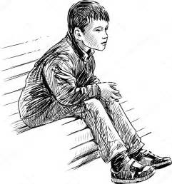
Skipping school could make a young person
more vulnerable to harm because...
You might be pressurised into doing something you don’t want to do, like smoking, drinking, breaking the law or sexual things.
Outside of school it’s not easy to know who is a safe adult.
Adults who may want to take advantage of children will find it easier.
You might end up in a risky situation from hanging out with the wrong people.

Slide 11
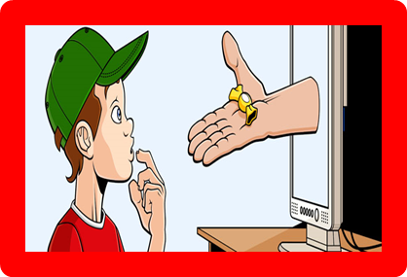
Let’s put it all together
What is online grooming?
Where can online grooming happen?
How can you stay safe online?
What should you do if you
think you’re being groomed?

Slide 12
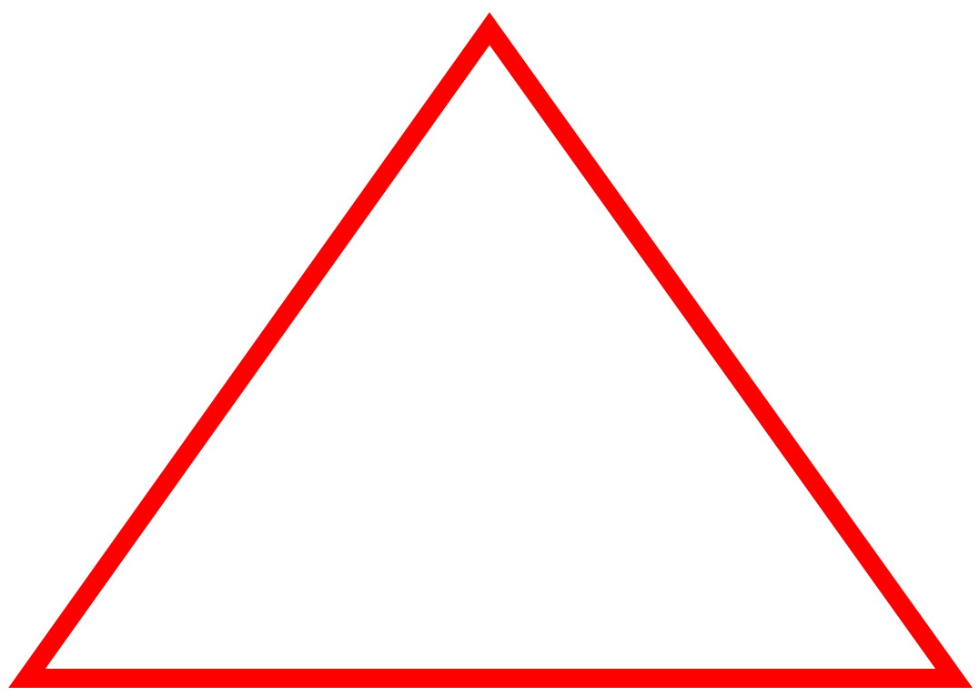
Warning!
Create a warning message that would help young people stay safe

Slide 13
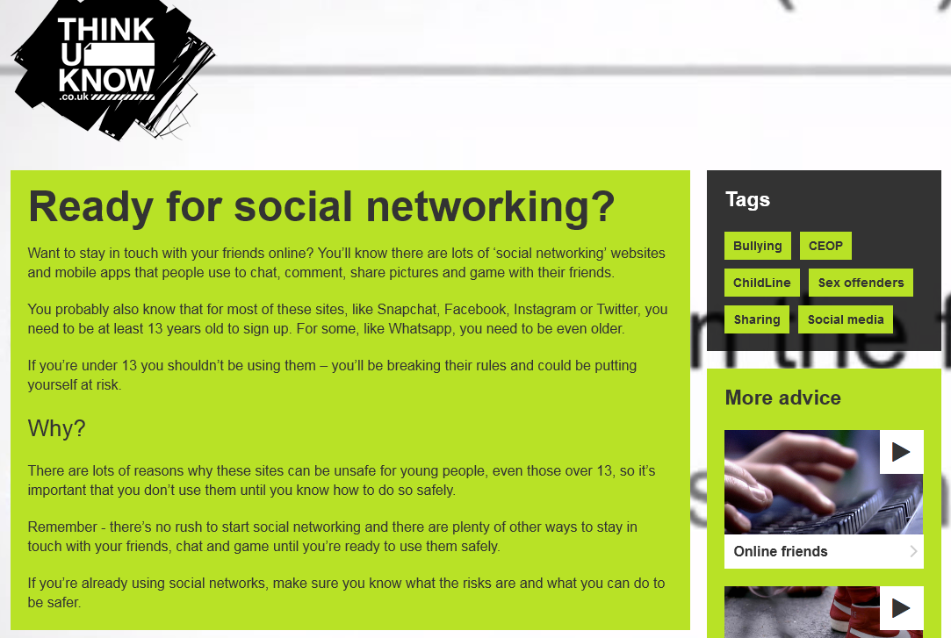
Think U Know
From NCA CEOP

Slide 14
Think U Know
From NCA CEOP

Slide 15
Today I learned…

