Slide 1
Risky Pics
Resource 13a.
To post or not to post?

Slide 2
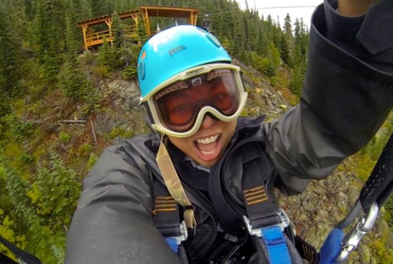
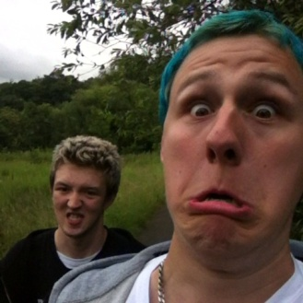
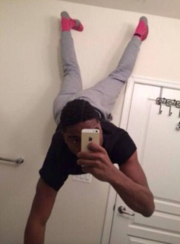
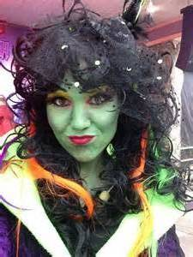
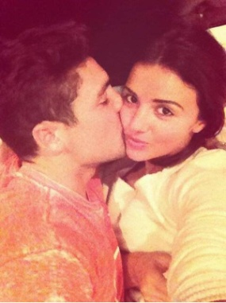
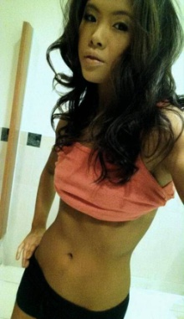
Sorting activity
Group images into categories of your own choice.

Slide 3
What categories would your selfies fall into? Which categories are you most comfortable with and least comfortable with?

Slide 4
Do you think there would be any positive outcomes as a result of someone posting any of these images online? Say what these positive outcomes would be?

Slide 5
Do you think there would be any negative outcomes as a result of someone posting any of these images online? Say what these negative outcomes would be.

Slide 6
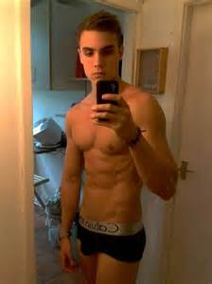
Which of these images may have the most significant consequences if posted and why?

Slide 7
The Law
In law it is illegal to make, take, possess or distribute, any image of a person under 18 that is naked or semi-naked (e.g. topless girl).
This law is meant to protect young people from exploitation.

