Slide 1
The outcomes...
Resource 6b.
Notes:
Lowri
Lowri’s relationship with Azuben ended. She was so devastated by the whole incident that she had to change schools. She became very depressed and didn’t want to go out. She had counselling from the school counsellor, which helped; however, her grades in school dropped and she didn’t do as well as expected in her GCSE exams.
Ryan
Was questioned by the Police and only escaped more serious outcomes when Marcus owned up to what he had done. The 5 days before Marcus came clean were a nightmare for Ryan, who experienced a lot of hostility from the online community. He was too worried and anxious to go to school during this time.
However, he got a lot of sympathy when the truth came out. He never again forgot to log out of his online accounts. He and Marcus are no longer friends.
CLICK for next slide

Slide 2
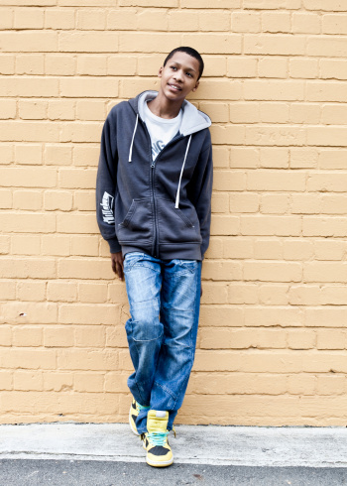
The outcomes...
Azuben
Marcus
Notes:
2
Azuben
Like Ryan Azuben was spoken to by the Police. Lowri finished with him. His friends ignored him and his parents who were disappointed with his behaviour took his mobile phone off him.
Marcus
Marcus escaped prosecution. Marcus, although very sorry for the harm he had caused Lowri, ended up losing all his friends.
He was given a Youth Conditional Caution by the Police.
Marcus could have been prosecuted for possessing and distributing an indecent image of a child. A child is anyone under 18 years of age. As a result he would be unable to work with any vulnerable people or children and never be able to travel abroad. Penalties in Law range from a 6 month sentence and fines to up to 10 years in prison.
Any young person found guilty of taking, possessing or distributing an indecent image of a child faces the possibility of imprisonment and/or being placed on the sex offender register for life if you are dealt with by a Crown Court.
CLICK for next slide.

Slide 3
The outcomes...
Kat
Naomi
Notes:
3
Naomi and Kat
Both girls had done the right thing in deleting the topless photo from their phones. When police checked their phones there were no indecent images to be found. They were commended for taking the right action. They remain friends with Ryan but only occasionally hear from Lowri.
End

