Slide 1
Who am I?
Resource 1
1

Slide 2
Community
friends
My identity
identity
Community
(other)
Community
(family)
identity
Person
identity
identity
Community
(other)
2

Slide 3
Mind map using the approach in the layout on the previous slide to answer the following questions:
Where are you from? (Community/ family)
What are you like?
What do you like doing?
What are you good at?
What do you like about yourself?
Does your partner agree with the detail you have put into your diagram?
3

Slide 4
Who am I?
4

Slide 5
A teenager
Working individually,
finish the following
statement:
I think that a typical teenager …..
Write down 2 statements you think are true about a typical teenager.
5

Slide 6
Statements about a typical teenager :
Young people do not care about other people’s property.
Teenagers spend a lot of their time fighting in gangs.
Most teenagers carry a knife when they are out in the evening.
Teenagers think that smoking makes them look cool.
Teenagers think they should not get involved if they see someone being bullied.
6

Slide 7
Teacher led discussion of the statements
Why do you think the media presents teenagers like this?
Do you believe these statements are true?
Can you think of any other groups which might be misrepresented in the media?
7

Slide 8
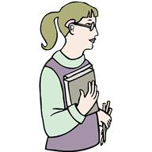
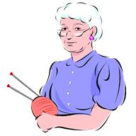
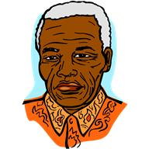
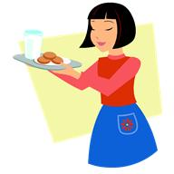
Stereotyping is…a belief that all members of specific groups share similar characteristics and will behave in the same way.
8

Slide 9
True or False?
5 minutes to complete!
 | Statement | True | False
1 | Britain is swamped with refugees
2 | We are being ripped off
3 | Asylum seekers are lazy
4 | Refugees are here because of the danger they face in their own country.
5 | Asylum seekers and refugees take our homes.
6 | All refugees are con artists.
7 | Asylum seekers take our jobs.
8 | Refugees make a valuable contribution to the economy.
9 | We pay more Council Tax because of asylum seekers.
9

Slide 10
Teacher Feedback and discussion
Myth: Britain is swamped with refugees.
False - Britain is in 10th place in Europe per head of population for asylum applications. The vast majority of refugees end up in the Middle East and Africa.
Myth: We are being ripped off.
False - The total amount of money and vouchers asylum seekers can get is 70 per cent of what someone on income support would receive. This works out around £30-£40 a week
10
Notes:
New asylum seekers in the UK get vouchers for food and essentials. A young, single person gets £19 a week, a couple gets £47 per week and extra for children. They also get £10 cash a week.
The total amount of money and vouchers asylum seekers can get is 70 per cent of what someone on income support would receive.
The money comes from the Home Office - the Government department which looks after asylum issues.

Slide 11
Myth: Asylum seekers are lazy
False - Many are really skilled and want to work and we have a shortage of skilled workers.
Myth: Some refugees are here because of the danger they face in their own country.
True - Because in some countries people do not have human rights and their government can do as it likes. Refugees have been through the asylum seeking process which decides whether they have good reasons to stay.
Myth: They take our homes
False - When they are given a house or flat, asylum seekers get the ones that are empty or the properties landlords find difficult to let.
11

Slide 12
Myth: Asylum seekers take our jobs.
False- Asylum seekers are not allowed to work while going through the asylum seeking process.
Myth: Refugees make a valuable contribution to the economy.
True- Many refugees have jobs and pay tax.
Myth: We pay more Council Tax because of asylum seekers
False- Asylum seekers are looked after by the Government, not local councils.
Myth: All refugees are con artists
False- Even though the Home Office is being tough on refugees applying to stay in Britain, last year, over 40% of applicants were given permission to stay because of the danger they would be in if they went home.
12

Slide 13
Consider: The UK hosts a small fraction of the world’s refugees – less than 3%.
Make your mind up!
Have the discussions affected what you think about teenagers and asylum seekers/refugees?
If so – how?
13

