Slide 1
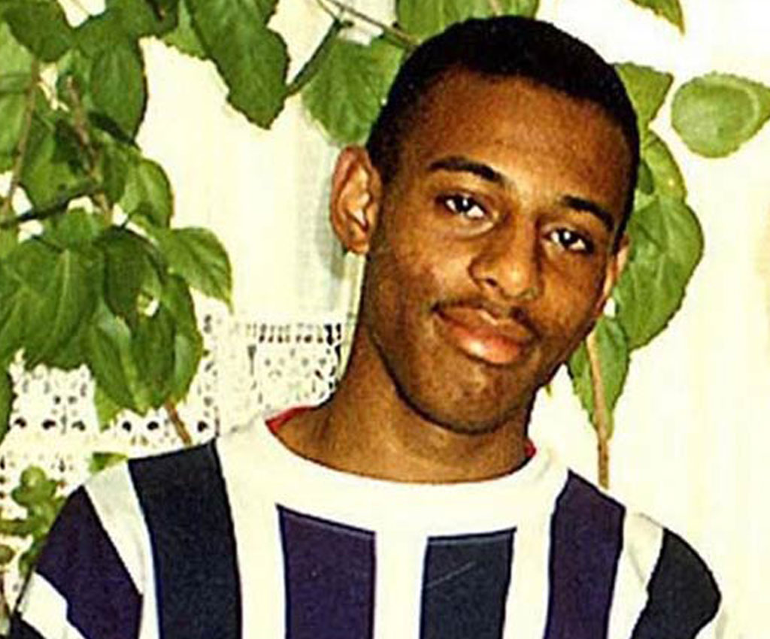
Save Me

Slide 2
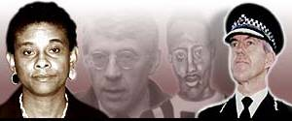
A fight for justice: The Stephen Lawrence story
It all goes back to a spring evening in 1993. Late on 22 April an 18-year-old A-level student called Stephen Lawrence and his friend Duwayne Brooks were making their way home after spending the day together.
The boys were rushing to catch a bus in the south-east London suburb of Eltham - Stephen was already late - when they were confronted by a gang of white youths.
The gang set upon Stephen. A stunned and helpless Duwayne briefly watched in paralysed silence, before he was chased off by one of the white youths.
Driven by fear and adrenaline, Stephen, managed to scramble free as Duwayne urged him to "just run". But he had been stabbed and was bleeding profusely.
He collapsed after 200 yards in a pool of blood and died.
A government inquiry and a report followed called the Macpherson Report. As a result the Race Relations (Amendment) Act 2000 followed.
2

Slide 3
Why do you think this murder happened?
I want to know…..
With your partner
suggest 2 questions you
want to ask about the
article ……

Slide 4
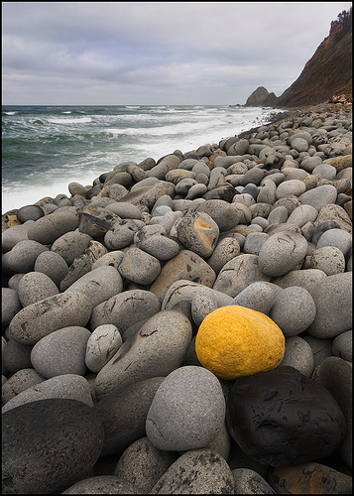
Discuss
In pairs:
What makes each of you unique in your classroom
environment?
What similarities do you share with other people in the class?
FEEDBACK
4
Notes:
Eg.

Slide 5
What is Prejudice?
Prejudice is …
An unreasonable opinion about a person or group of persons, formed beforehand, without any real knowledge of the person or group.
5

Slide 6
Discuss
Did you raise any points that might reveal
prejudice?
6

Slide 7
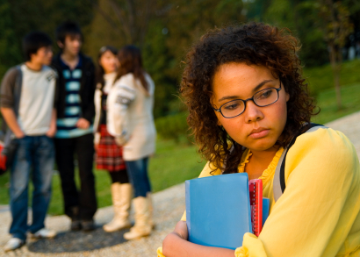
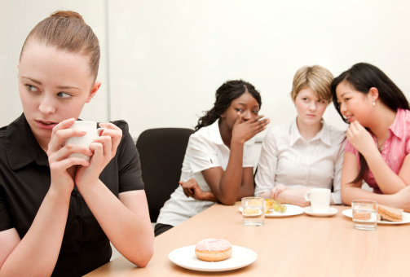
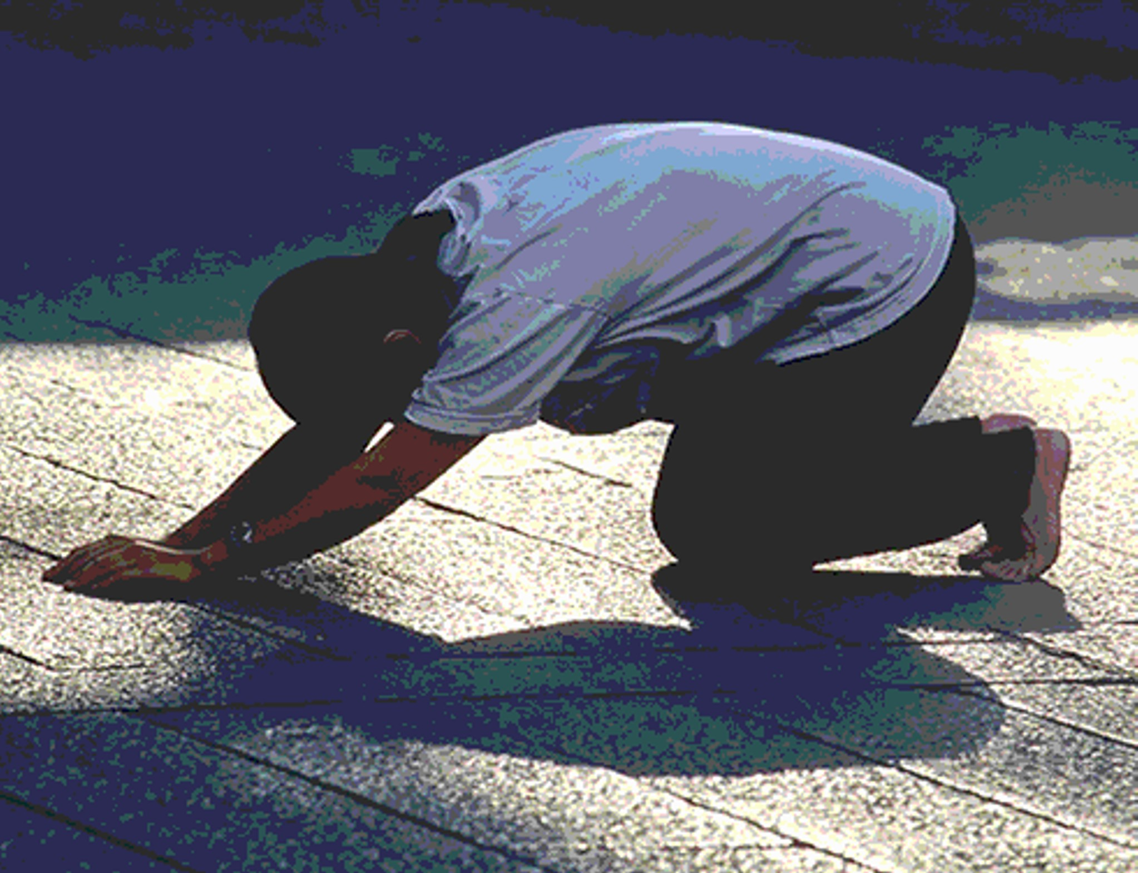
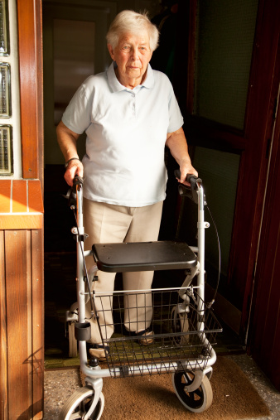
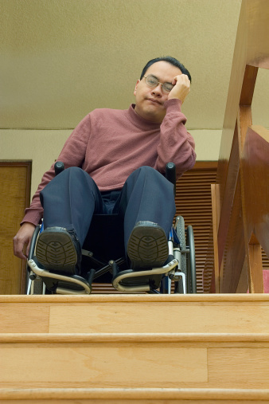
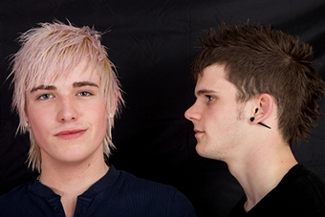
Discrimination is ….
treating people differently based on their actual or perceived membership of a group

Slide 8
Causes of discrimination????
 | Influencing factors | Not likely | Quite Likely | Very Likely
1 | Clothing
2 | Gender
3 | Hair colour
4 | Sexual orientation
5 | Culture
6 | Height/weight
7 | Transgender
8 | Disability/family
9 | Religion
10 | Colour of skin
11 | Working hard in school
12 | Wearing glasses
8

Slide 9
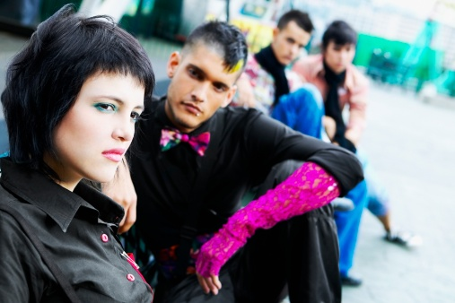
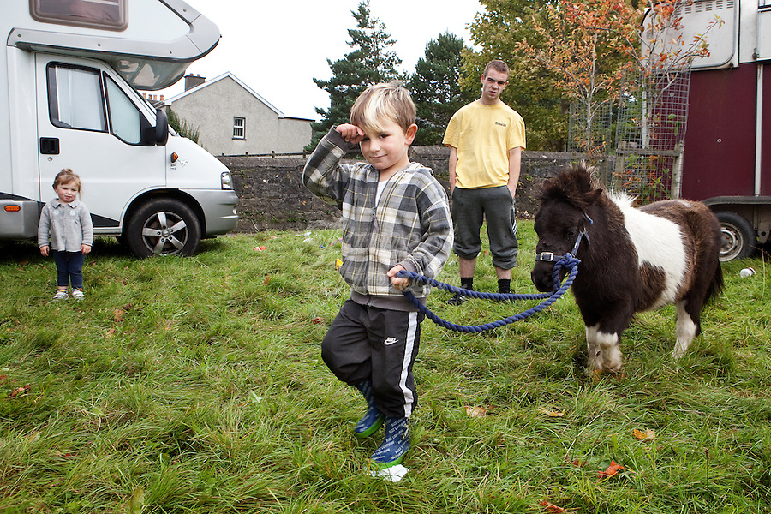
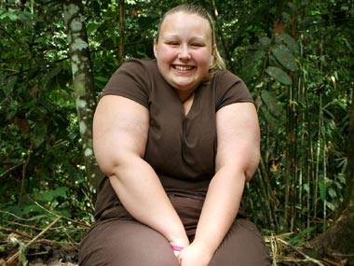
Discrimination Scenario Card Activity
In pairs/groups read the scenario card. Discuss in your pair/ small group
What happened in the scenario?
What kind of discrimination has taken place?
How do you think the main character/s may feel ?
What would you advise the main character/s to do?
What would you advise them not to do?
9

Slide 10
1 Anya and Joe’s story
10

Slide 11
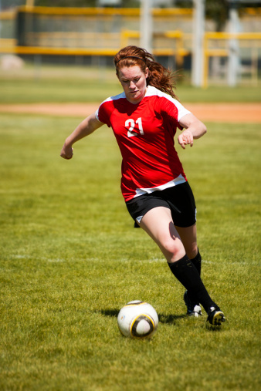
2 Stacey’s story
11

Slide 12
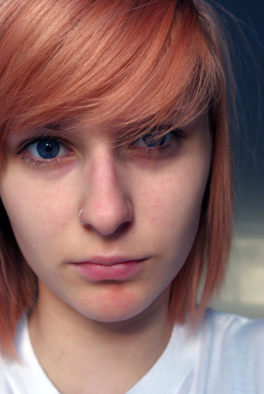
3 Seren’s story
12

Slide 13
4 Jamie’s story
13

Slide 14
5 Kieran’s story
14

Slide 15
6 Tanya’s story
15

Slide 16
7 Margo’s story
16

Slide 17
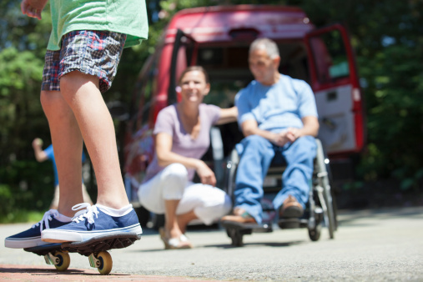
8 Gareth’s story
17

Slide 18
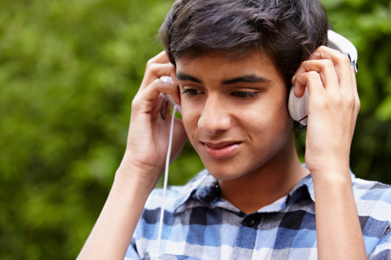
9 Ravi’s story
18

Slide 19
10 Kayleigh’s story
19

Slide 20
Now consider the following information:

Slide 21
1996 survey of under 18 gay, lesbian or bisexual young people showed:
48% had experienced violence
61% had been harassed
90% had been called names because of their sexuality
50% of violent attacks involved fellow students
40% of attacks took place at school
They found that 60% of pupil suicides in the
UK were directly related to homophobic
bullying.
21

Slide 22
Were you surprised by these details?
Class vote
In pairs discuss why these groups are more likely to suffer bullying and violence.
Suggest any other groups who might face bullying.
22

Slide 23
Combating Racism
In pairs suggest 2 reasons for racism.
Feedback your reasons to the class
23

Slide 24
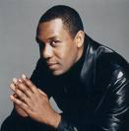
Lenny Henry on Racism
What you do with racism is reject it.
Some people say 'I don't let it get to me'. But you must say something if you think somebody is being deliberately offensive.
Peer groups are very difficult - after all, they're your mates! So what you have to do is say 'I'm really uncomfortable with that line of humour and I'm finding it offensive. Could you just back off with that?'
And sometimes sarcasm, like 'Yeah, that's right, we do have spears, ‘cos I'm from Dudley y'know, and we always walk down the street with spears' works.
In the real world that can get you hurt. You must act - walk out, do something. You don't have to be a victim.
24

Slide 25
In Pairs discuss and answer the following questions:
In what ways has the character in the scenario experienced racism?
How does the character feel?
What should the character do?
What can the school do to help the character?

Slide 26
Ibraim is a 13 year old black boy who has moved from Tunisia with his parents to a school in Wales. English is a second language for him and so he needs extra support from the school’s department for additional learning needs. He has struggled to make friends because of the language barrier. He has experienced being called names by other pupils and being mocked for having a different accent. He feels lonely and scared at times and is increasingly being left out by his peers. He feels that he doesn’t fit in as there are few pupils in his school who are either black or not originally born in Wales. He feels like running away.

Slide 27
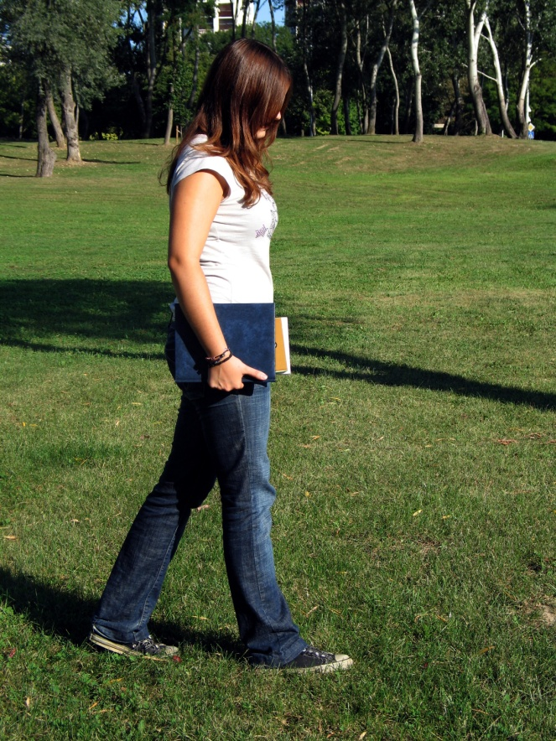
Svetlana is a bright 15 year old Romanian girl who has recently moved with her family to live in Wales. Her father is a doctor and has high expectations for her. She was very nervous about starting at her new school as the head teacher said that she was the first pupil that they had join them from Romania. Although she has good English she finds it hard to make friends. One girl started a rumour about her that she was a Gypsy traveller, and that she was living in a caravan on wasteland near the local canal. After 5 weeks nobody really speaks to her unless it is to make a mean comment about her supposed cultural background. She is very distressed about school and this is now affecting her grades.

Slide 28
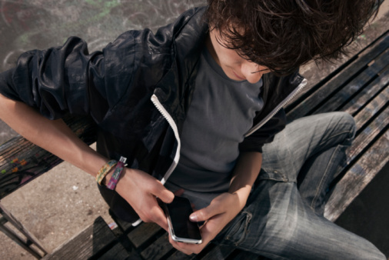
Calvin is a 14 year old boy that has moved schools in the city of Swansea where he lives. His mum is white and his dad is of Asian origin. He has recently experienced some unpleasant comments by some older boys about his dad after a recent parents evening. He found the racist remarks very hurtful. Since the parents evening he has been experiencing racist comments and slurs about him, such comments as him being a terrorist. They make jokes to other pupils who although it seems to Calvin are uncomfortable with this , no one ever speaks up for him. His friends have told him just to ignore it. He has recently been receiving nasty texts and rude comments have been left on his facebook page along with some threatening messages. Calvin feels increasingly unhappy and unsafe at school and in his community.

Slide 29
What can schools do to help reduce instances of racism?
In groups mind map your ideas

Slide 30
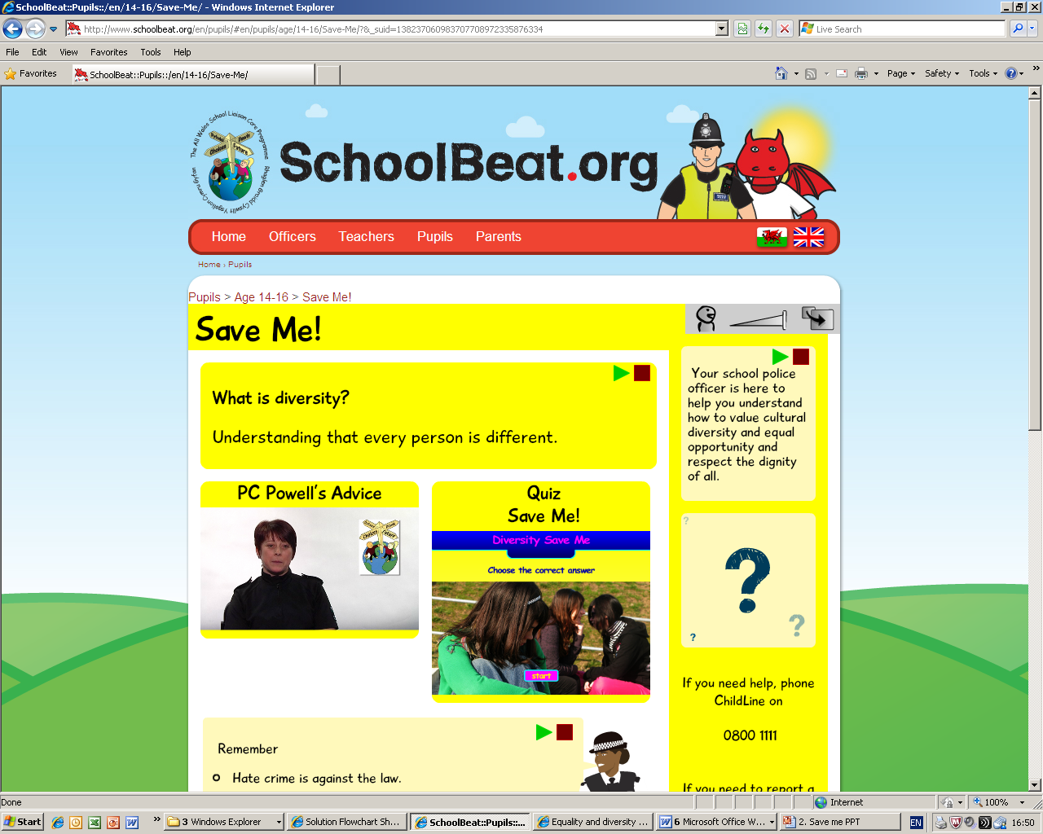
For more information checkout www.schoolbeat.org

